Slide 1
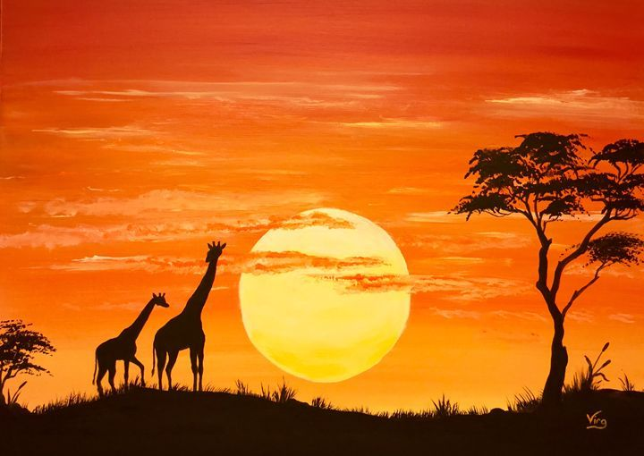
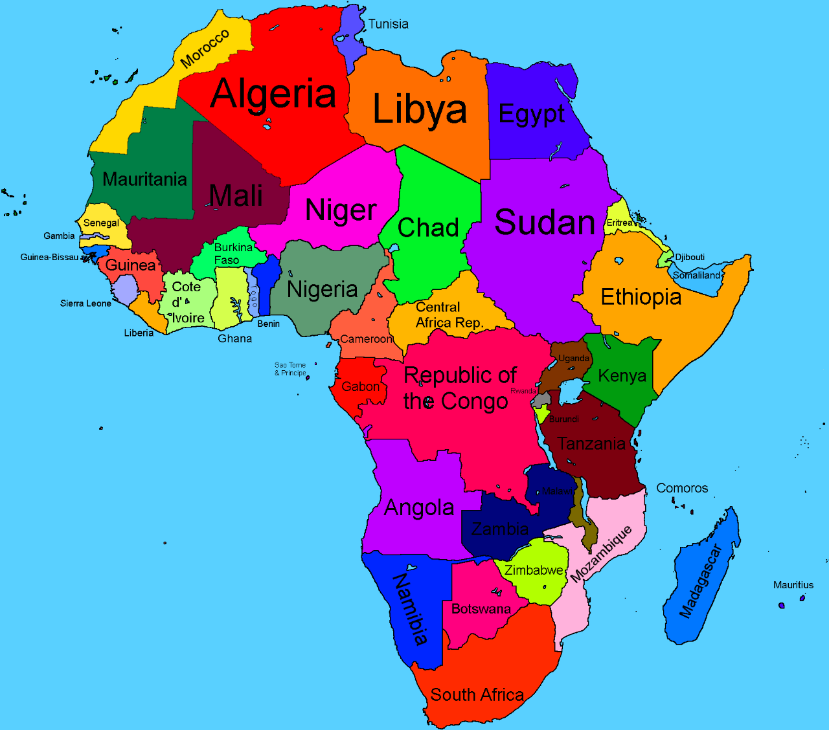
Africa

Slide 2
Where is Africa?
Use Google Earth to find out where Africa is
Google search – Google Earth
Click on ‘Explore Google Earth’.
Search – Type in Africa
Click and drag on the ‘little icon person’ to see different parts of Africa.
You can fly back home to your destination i.e. From Africa to Stannington (click on the different icons in the bottom right hand corner).

Slide 3
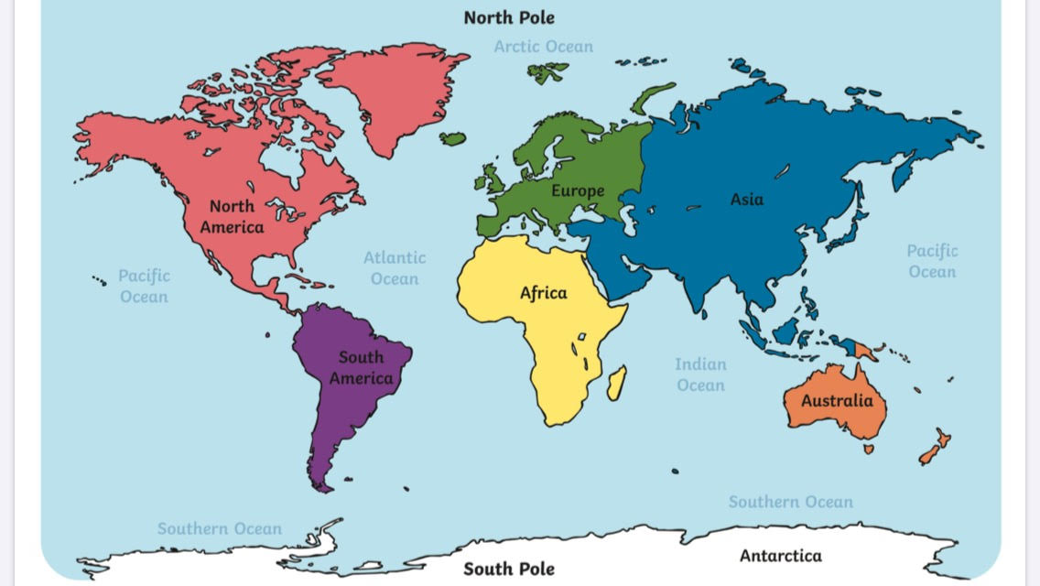
Can you find Africa on the world map?

Slide 4
The World’s Continents
There are 7 continents across the world.
Can you name them all?
Can you learn this song to help you remember the 7 continents?
Europe, Asia, Africa, North America, South America, then there is Antarctica, don’t forget Australia, 7 continents, 7 continents.
https://www.youtube.com/watch?v=4ls9yVu5VPg
Parents/carers – In school we explain to the children that on some maps or resources the continent of Australia is sometimes referred to as Australasia or Oceania, and that these terms are also correct.

Slide 5
Can you learn this song to help you remember the 7 continents?
There are 7 continents across the world.
Can you name them all?
Europe, Asia, Africa, North America, South America, then there is Antarctica, don’t forget Australia, 7 continents, 7 continents.
https://www.youtube.com/watch?v=4ls9yVu5VPg

Slide 6
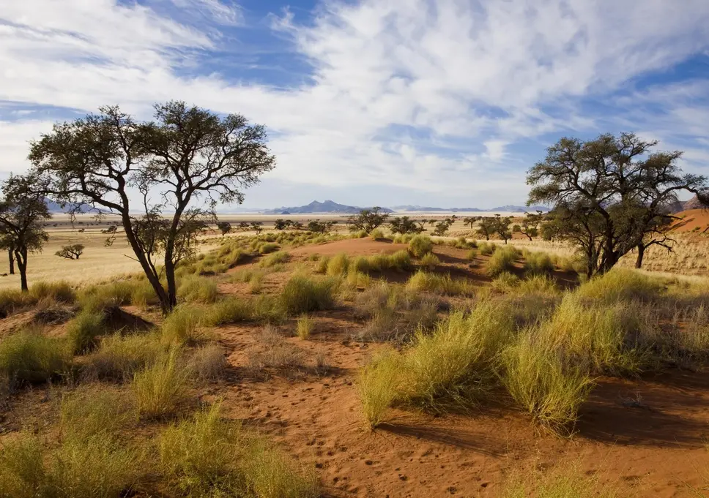
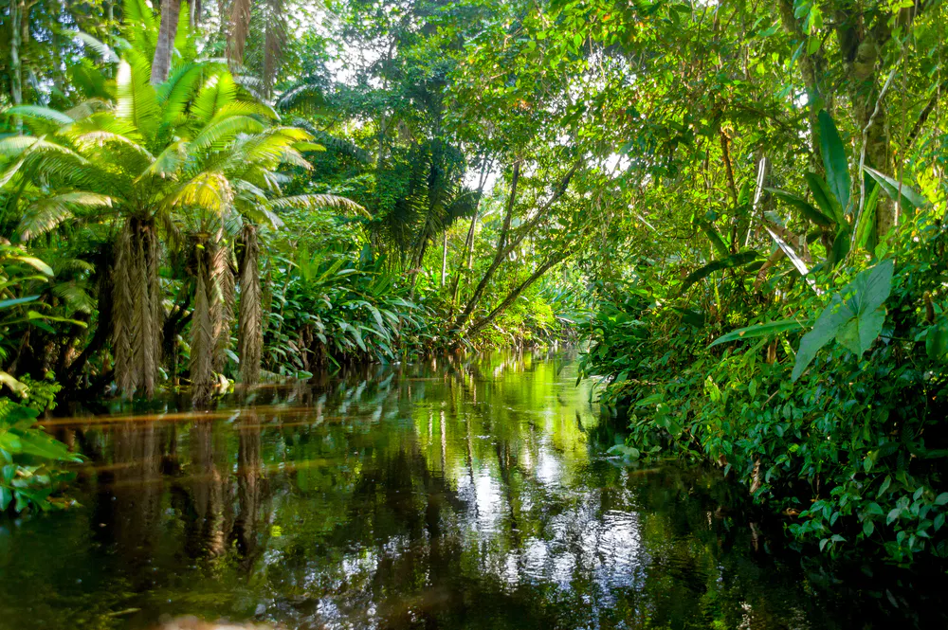
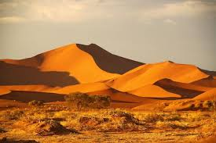
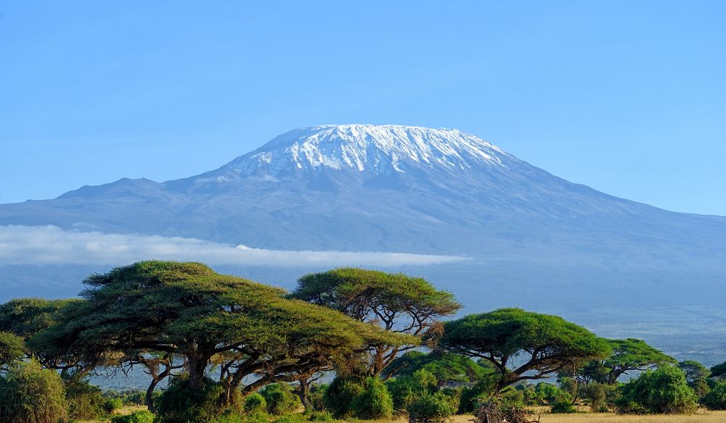
What can you tell me about these pictures?

Slide 7
Africa has 54 different countries. Maybe you could find out about one of them and write some facts? What is it like there?

Slide 8
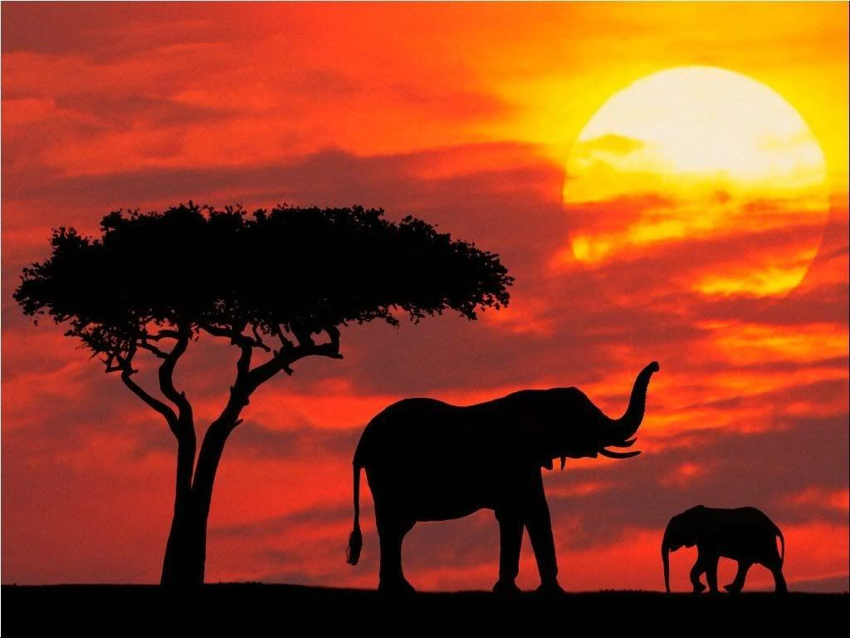
African sunsets

