Slide 1
Weekly Challenge 1

Slide 2
Important things to remember…..
These challenges have no one right answer.
You can choose to do them in different ways.

Slide 3
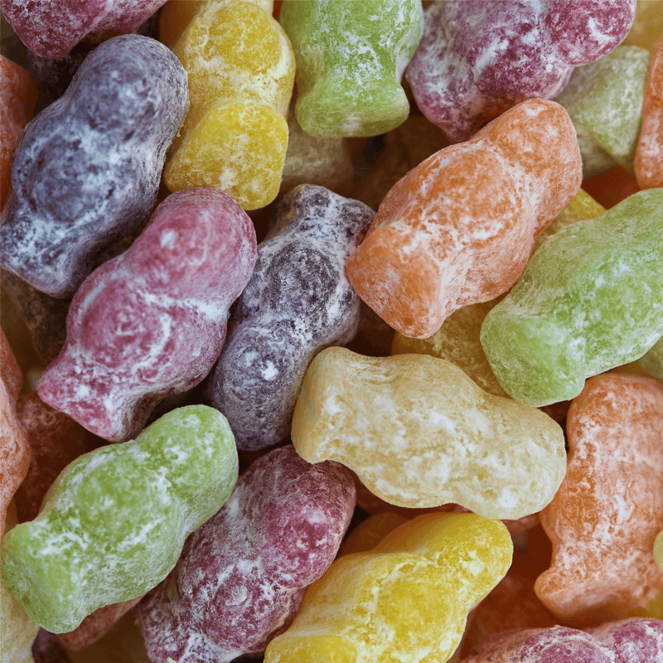
Jelly Baby challenge
How many Jelly Babies would it take to make a line 2 metres long?

Slide 4
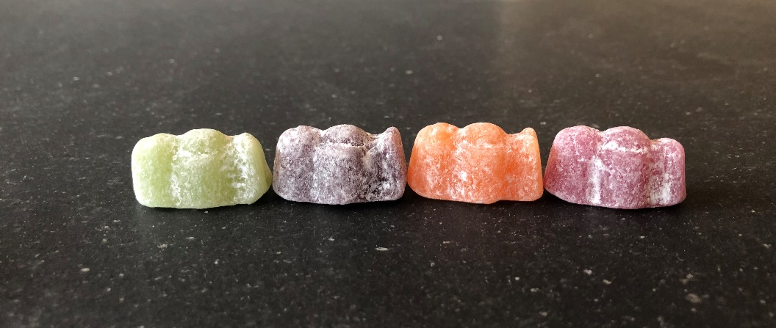
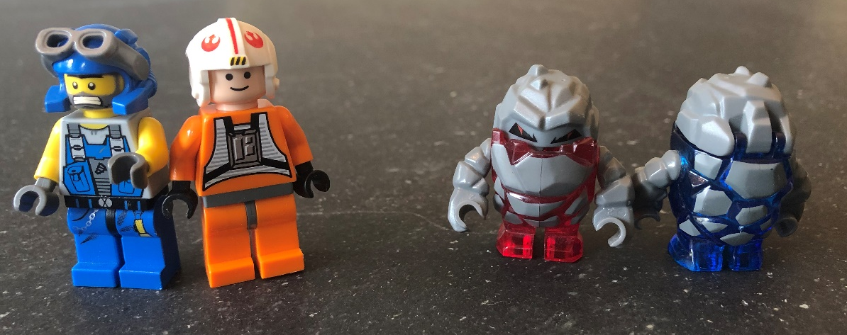
You can choose how you will line your jelly babies up….
If you haven’t got jelly babies you could use something else….

Slide 5
If you think you know the answer to this …
How many jelly babies would it take to go all the way along one wall in your room?
Or down your hallway?
Hopefully you will share your answer with school by sending an email, a photograph or a video.

