Slide 1
Weekly challenge 2

Slide 2
Important things to remember…..
These challenges have no one right answer.
You can choose to do them in different ways.

Slide 3
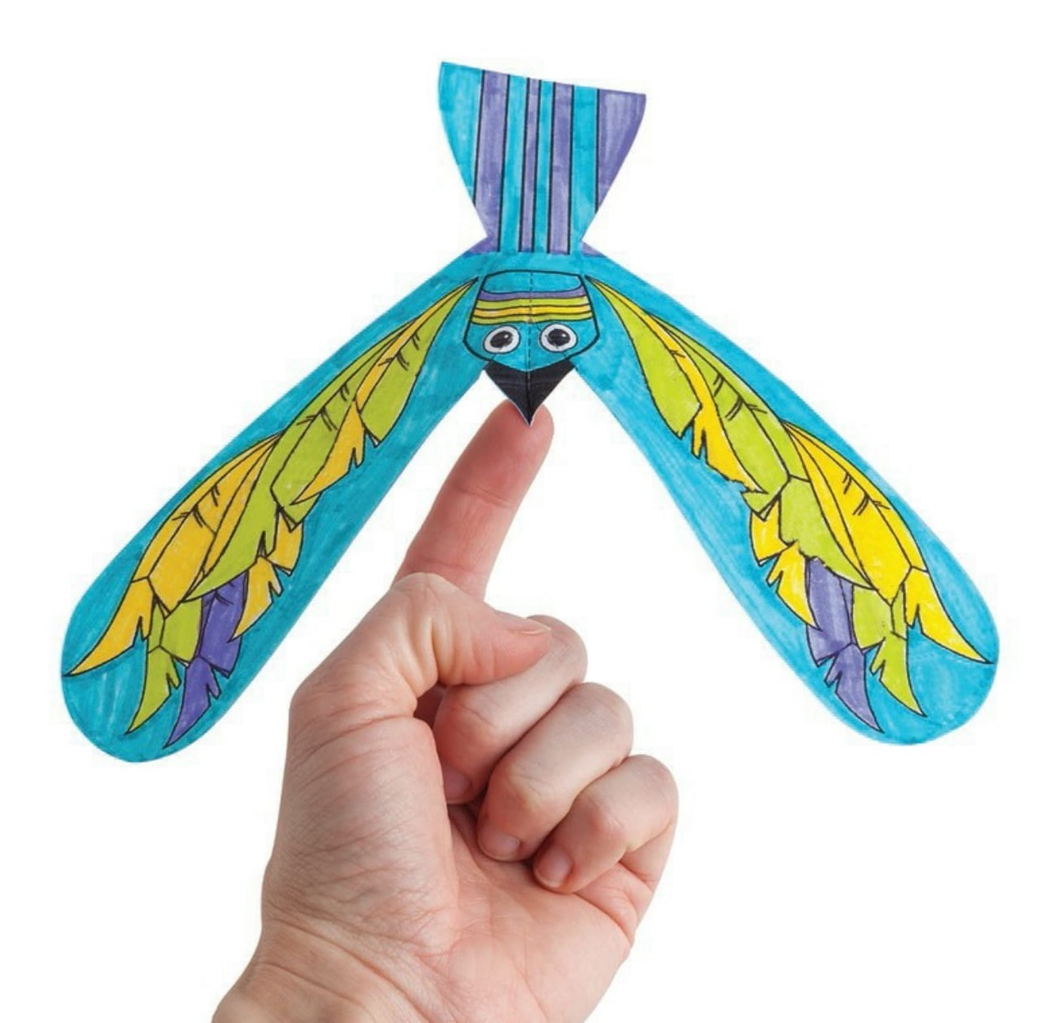
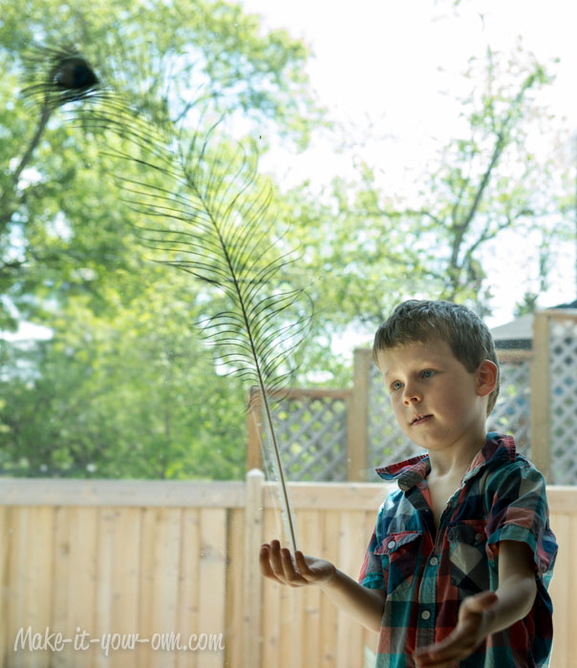
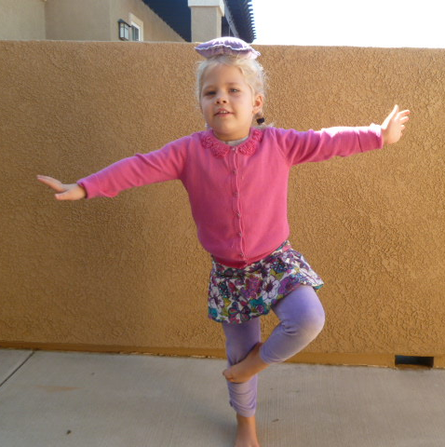
Balancing challenge
Can you make something that you can balance on your hand … or finger… or head?

Slide 4
Nathan made these butterflies that balance on his finger. He even challenged himself to walk with it balanced!

Slide 5
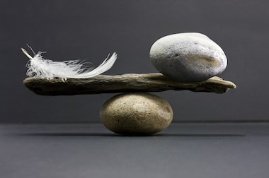
If you manage that why not try ……
You could try making a sculpture that balances
(don’t use anything precious or make it to big in case it falls!!)
Hopefully you will share your answer with school by sending an email, a photograph or a video

