Slide 1
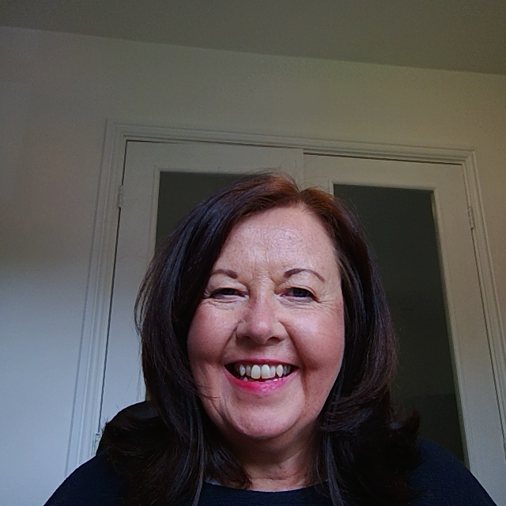
Weekly challenge 2

Slide 2
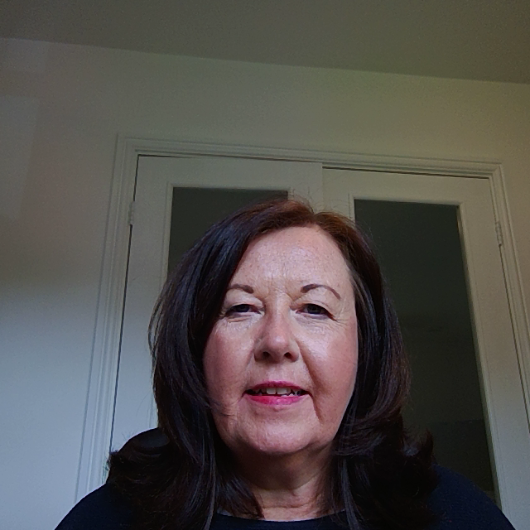
Important things to remember…..
These challenges have no one right answer.
You can choose to do them in different ways.

Slide 3
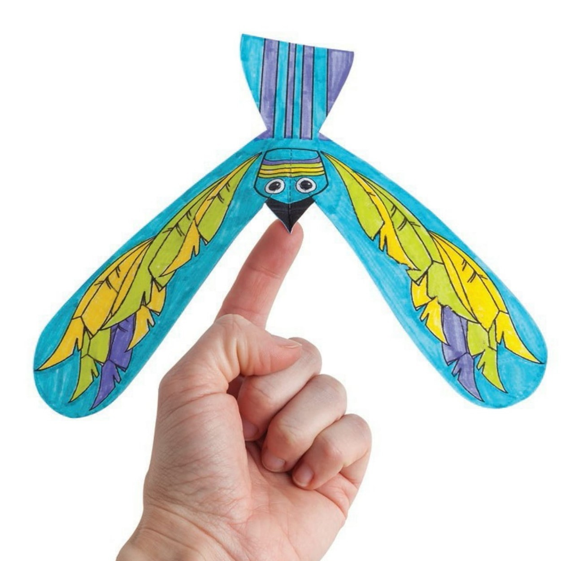
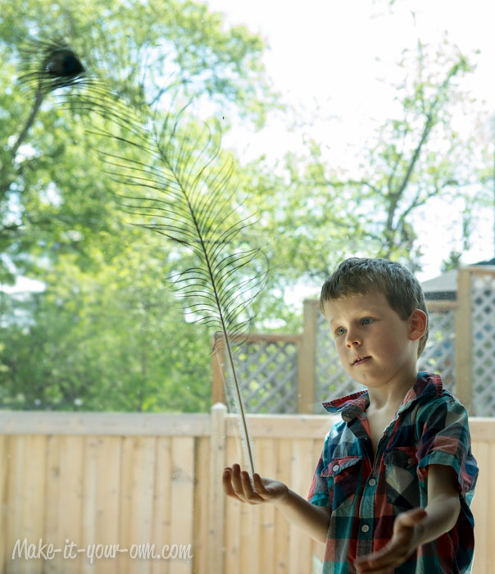
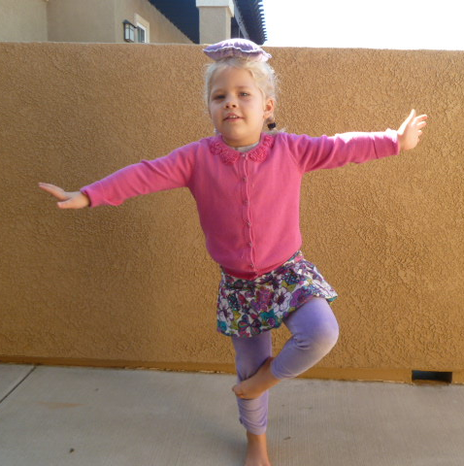
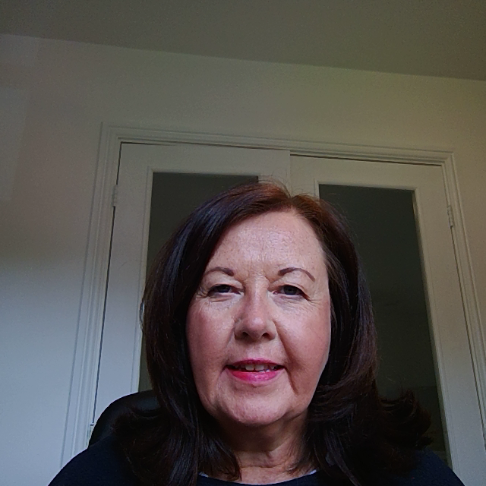
Balancing challenge
Can you make something that you can balance on your hand … or finger… or head?

Slide 4
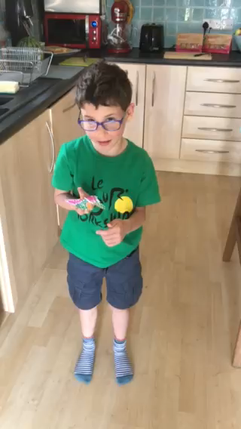
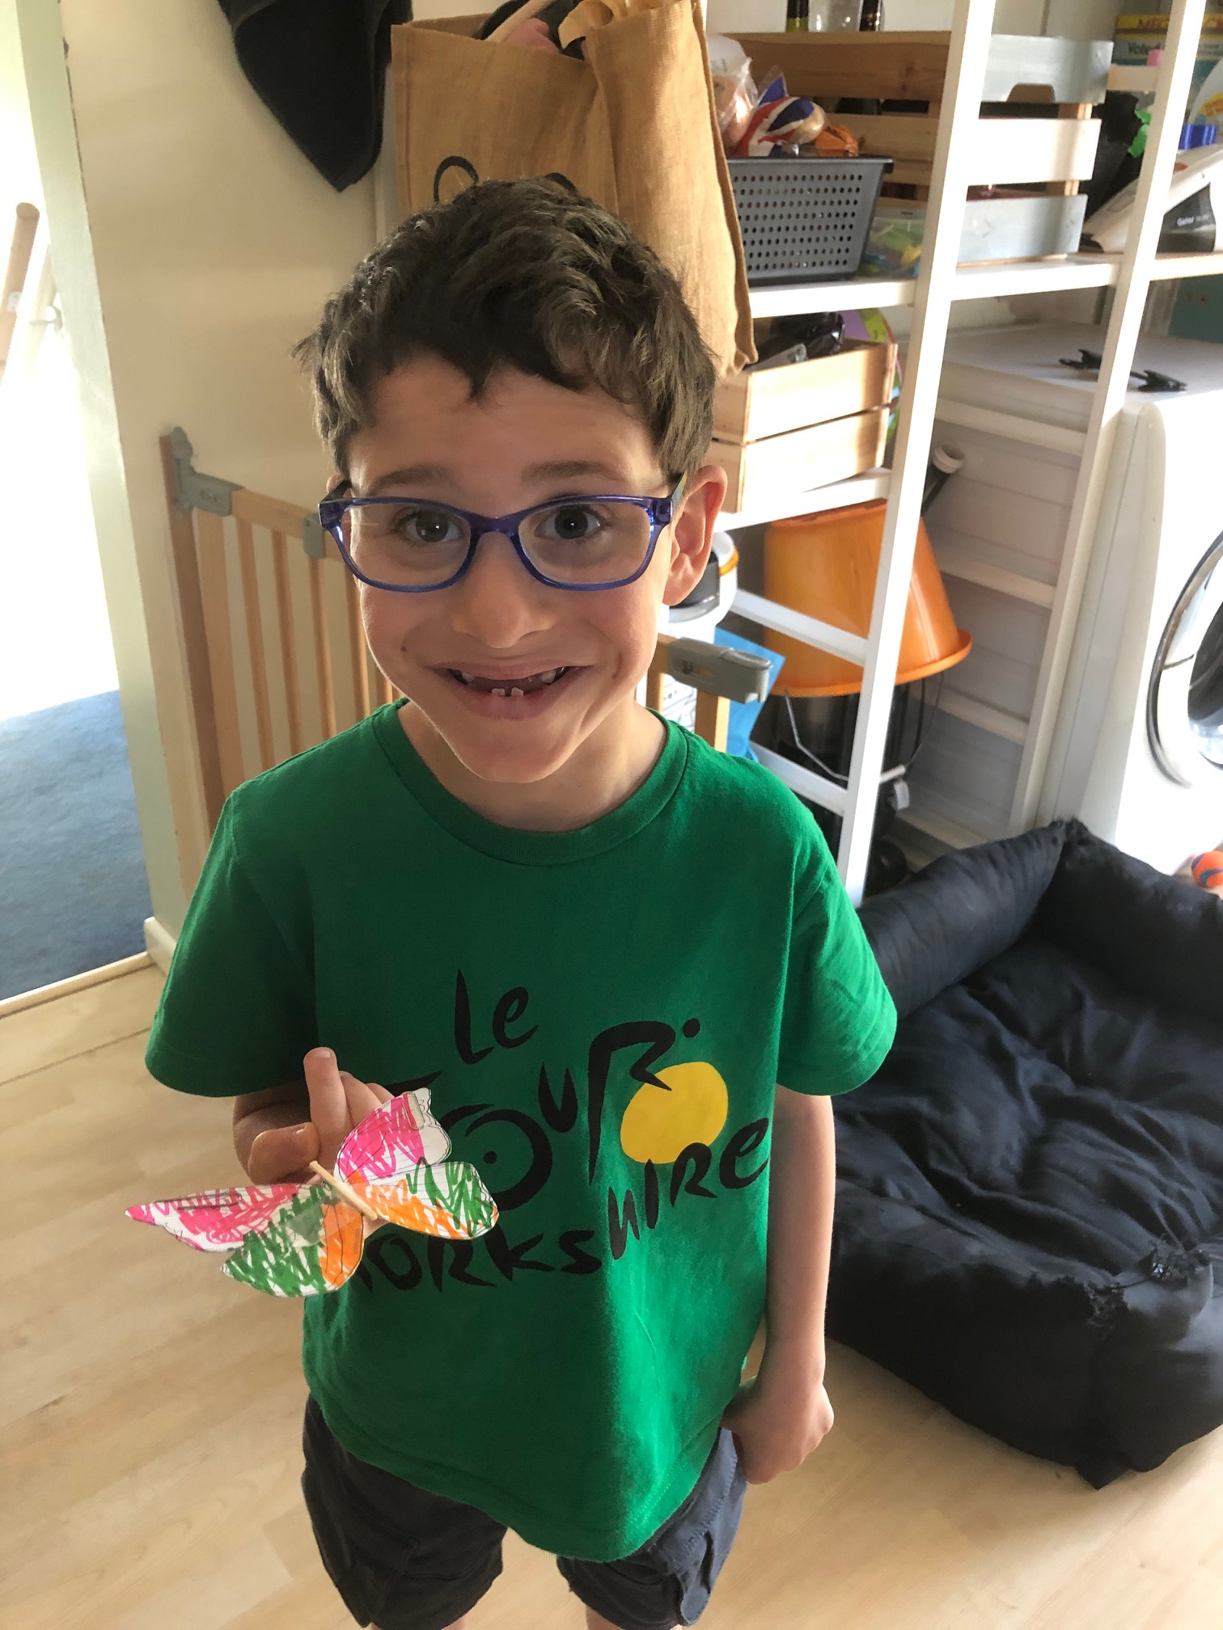
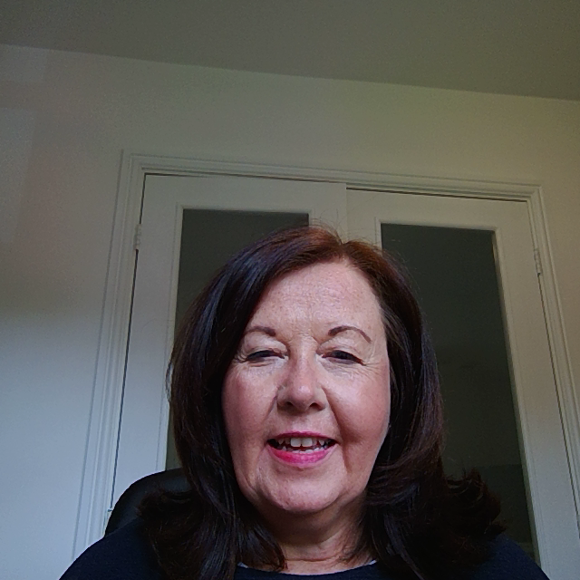
Nathan made these butterflies that balance on his finger.
He even challenged himself to walk with it balanced!

Slide 5
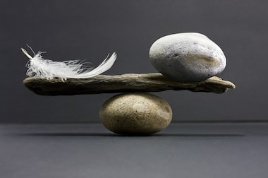
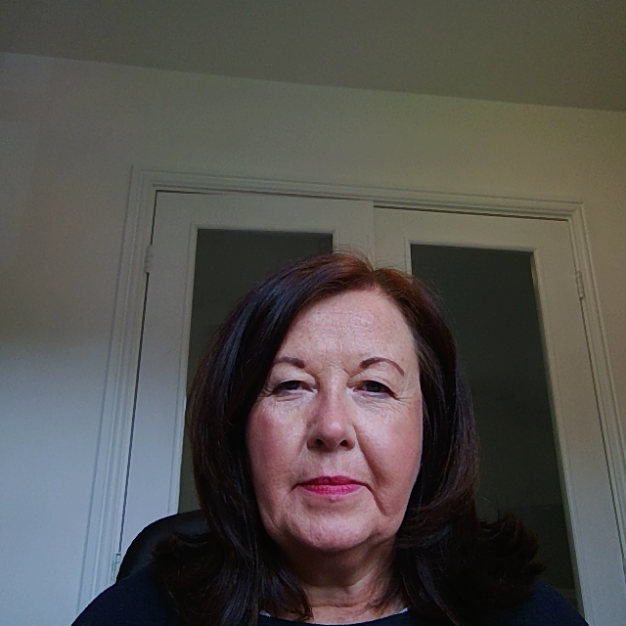
If you manage that why not try ……
You could try making a sculpture that balances
(don’t use anything precious or make it to big in case it falls!!)
Hopefully you will share your answer with school by sending an email, a photograph or a video

Slide 6
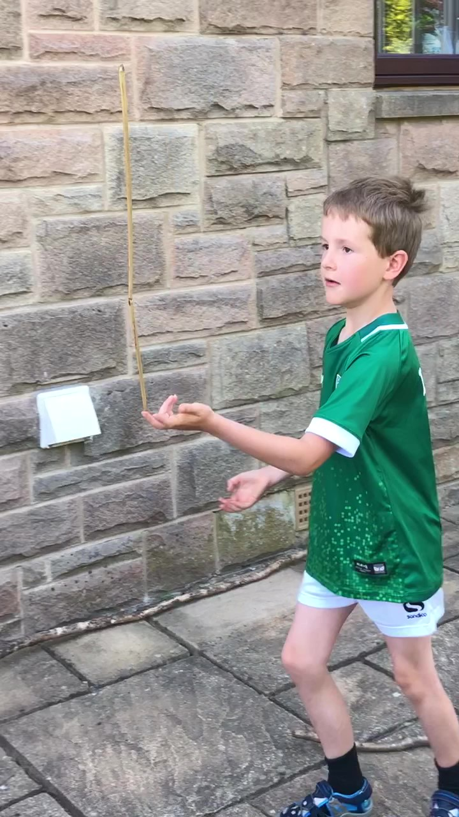
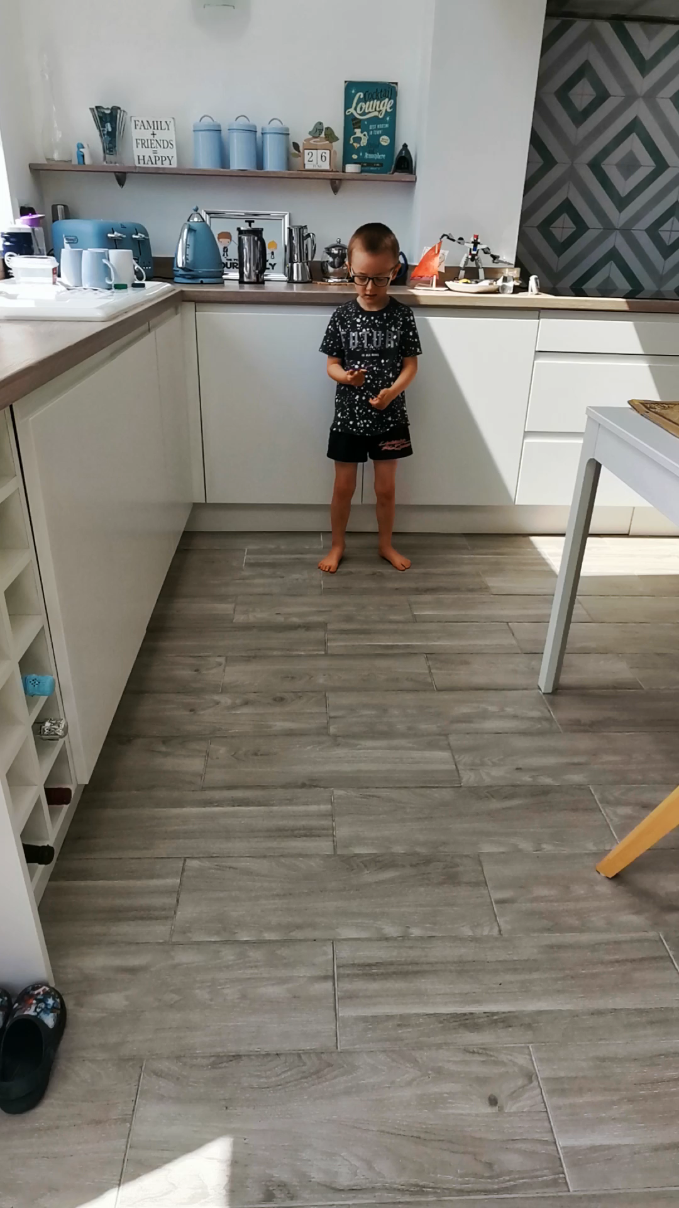
Wow! Look at that concentration. Well done Isaac.
Here is a video of Theo balancing a dragon fly!

Slide 7
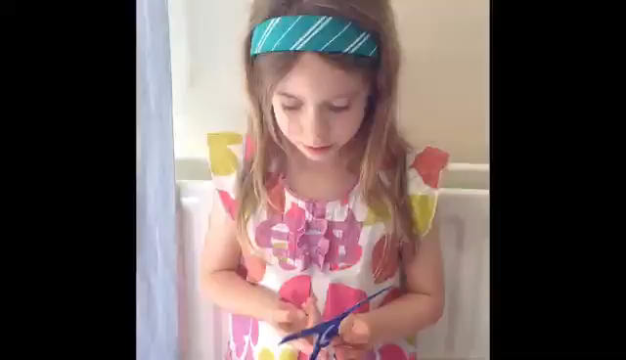
Abigail and Eliza have both managed to balance an acrobat on their finger!

Slide 8
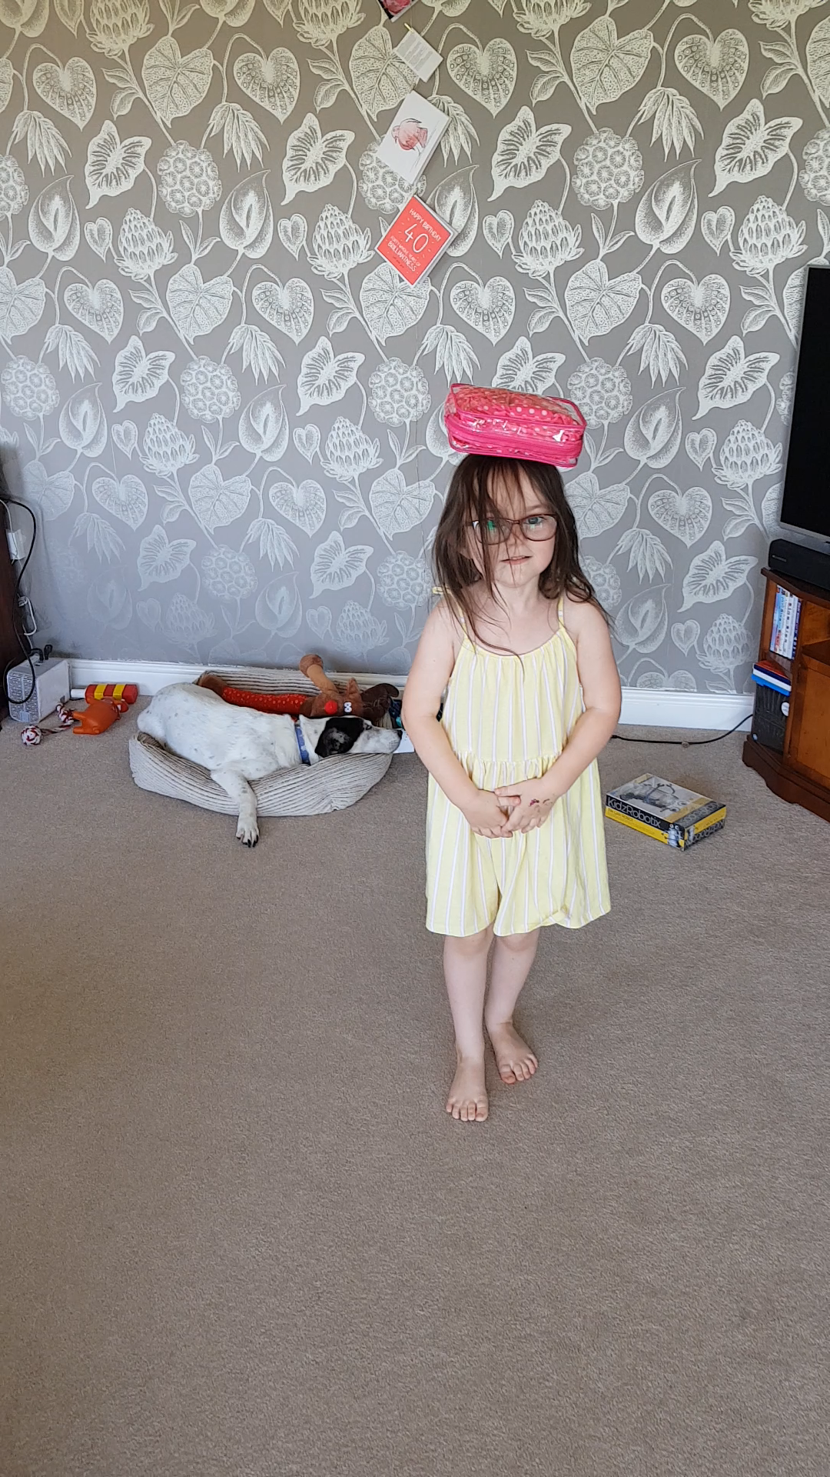
Georgie walked without wobbling!!

