Slide 1
Weekly challenge 3

Slide 2
Important things to remember…..
These challenges have no one right answer.
You can choose to do them in different ways.

Slide 3
How tall?
Sometimes when you win a prize you win ‘your height in books’
How many books do you think you would win?

Slide 4
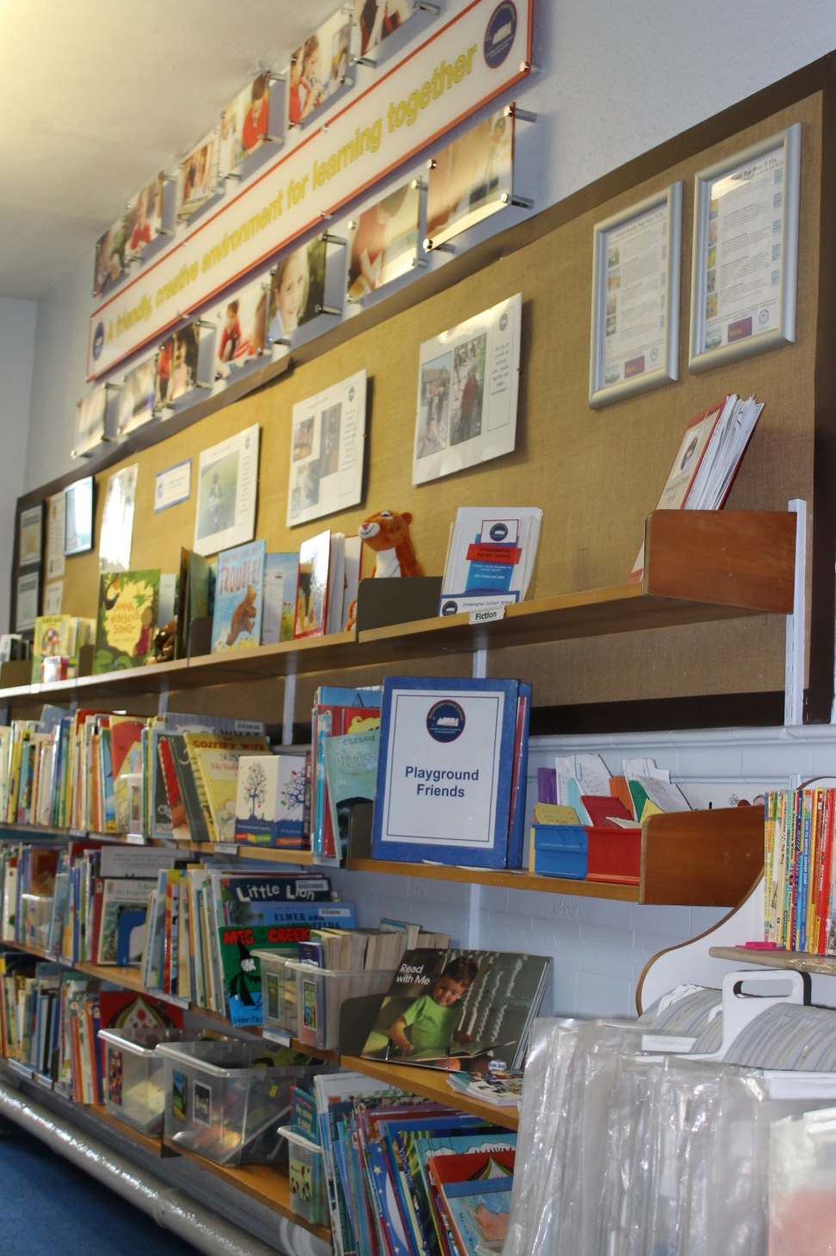
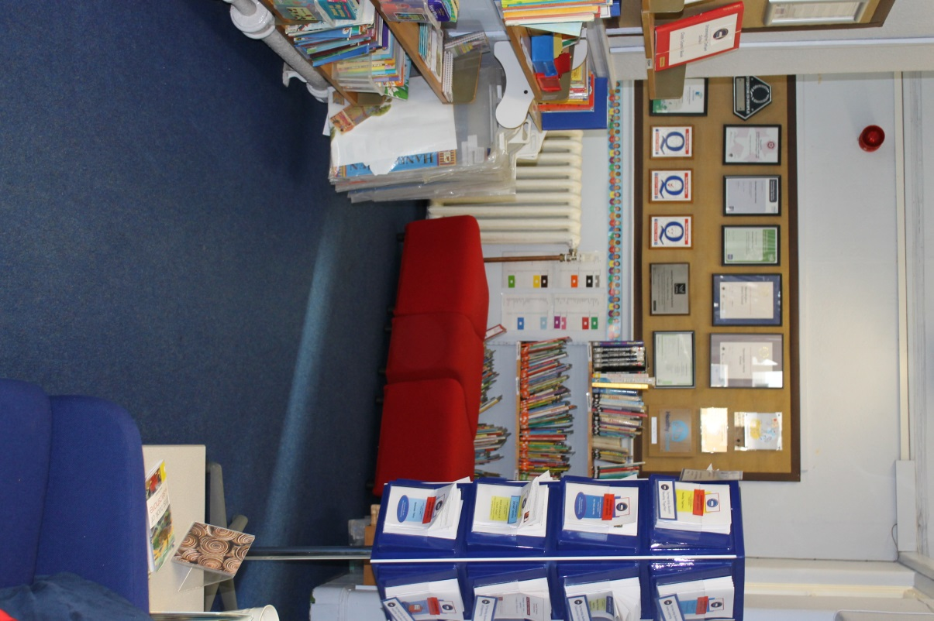
If you manage that why not think about ……
If all the books in our school library were stacked on top of each other in a pile how tall would it be?

