Slide 1
Spelling at Stannington Infant School

Slide 2
Spelling at Stannington Infant School
Being able to spell is an important life skill and part of being a writer.
We use the Early Years Foundation Stage and Key Stage 1 National Curriculums for guidance about when and which spellings to teach.
We teach spelling as part of our Phonics sessions and our teaching sequence in Literacy.
Today is about sharing different games and approaches you can use at home to support our child with their spellings.

Slide 3
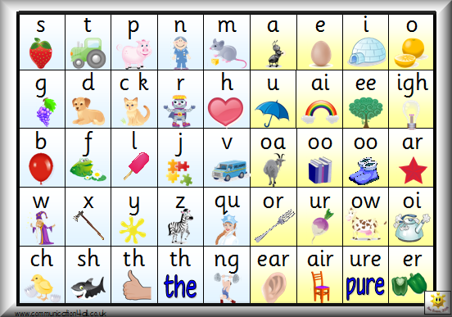
Notes:
There are 144 different sounds within the English language using the 26 letters of the alphabet!! So there is no wonder some children find it difficult to know whoch letters they need for which sound.
Take the word mother – it siunds like it could be spelt muther,, moother, muthir moothir

Slide 4
Have a go at spelling…..
Notes:
Flooberhopper could be flewberhopper, fluberhoppir

Slide 5
Children begin by spelling simple CV words such as ‘it’, ‘an’, ‘up’ and ‘in’
They then move to CVC words: ‘cat’, ‘dog’, ‘mum’ and ‘dad’.
Eventually they will need to choose the correct spellings in each word for a sentence such as ‘I can hear the owl hoot at night.’

Slide 6
The language of spelling
Phoneme – the smallest unit of sound in speech –
‘c –a – t’ three phonemes
‘l – o – f – t’ four phonemes
Grapheme – is a letter or a written number of letters that represent a sound –
‘sh’ ‘ch’ ‘igh’
Diagraphs – two or more letters that make one sound –
sh, tr, cl
Vowel diagraphs – two or more letters making one sound –
ai ee ew
Split diagraph – a consonant is in between two vowels –
made kite bite

Slide 7
How can you help at home?
In Foundation Stage we still use letter sounds rather than names when we are spelling:
c – a – t
sh – e –d

Slide 8
Use letters (plastic or on bits of cut up paper)
i s t a p n
Say a word and ask your child to find the letters to make that word.
As they become more confident and their letter recognition develops add letters and extend the words. Focus on CVC words to begin with then CCVC words like:
shed shop chop

Slide 9
Circle Spellings
Have a selection of words written on pieces of paper.
One person holds the words and reads the top word:
Happy
Next child says the first letter and uses its name:
H
Next child says the next letter:
A
Repeat until the whole word has been spelt out.
Final child say the whole word again:
happy

Slide 10
Spelling Aerobics
Have a selection of words written on pieces of paper or on a board that children can see.
One person stands in front of the others and chooses a word:
Happy (they introduce the word)
Then they spell the word a letter at a time using actions
H (tall letter action)
A (short letter action)
P (tail letter action)
P
Y (tail letter action)
Repeat the whole word.

Slide 11
Right or Wrong?
ise city sell fansy
bisycle mice rise

Slide 12
Silly Stories
Tell a silly story using that week’s spellings.
Each time you say one of the words your child has to write that word down.

Slide 13
Invisible Man
A variation on Hang Man!
We play in two teams and each time we correctly spell a word we can rub out part of the invisible man.
The first team to make their person disappear wins.

Slide 14
Only introduce a few games at a time.
When they become bored with it introduce another one.
Little and often is the key.

Slide 15
Adding / s /, / es / or / ies /
How do we know when to add / s /or / es / when pluralising words?
lunch day dog box
When do we add / s / or / ies / ?
Monkey story lady day
Notes:
If the number of sylables changes add es if not just add s
Vowel before the y add s consonant before the y add ey

Slide 16
Homophones
Put the following homophones into a sentence
no | know
by | bye | buy
bean | been
through | threw
new | knew
their | there | they’re
where | wear
weather | whether
to | too | two
male | mail
Notes:
I know Mum said no.
I said bye to Sam as I walked by the shop to buy a loaf of bread.
Have you been to the bean shop?

Slide 17
Spelling and reading – inextricably linked
Notes:
In KS1 classes children have this list of words in alphabetical order to help them to find the spelling they want more easily.

Slide 18
Questions?
Thank you for your time.

