Slide 1
Welcome to Year 1
July 2021

Slide 2
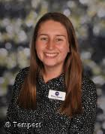

The Y1 Team
Teachers
Class 3 Miss Howell
Class 4 Miss Travis

Slide 3
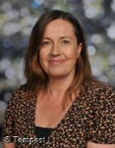
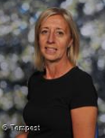
Teaching Assistants
Class 4 -Mrs Leaf Class 3 - Miss Woodhead
Mrs Leaf and Miss Woodhead are classroom based teaching assistants.
Notes:
Add Karen Leigh / Kelleigh W – briefly explain their roles

Slide 4

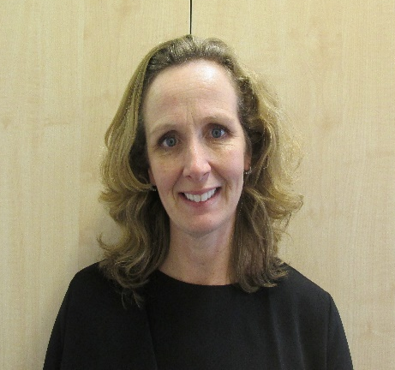
Teaching Assistants
Mrs Williams Miss Melville
Mrs Williams and Miss Melville support children in the classroom and at nurture.
Notes:
Add Karen Leigh / Kelleigh W – briefly explain their roles

Slide 5
The aim of this PowerPoint is to provide you with as much information as we can about Year 1. We know that many of you will have no experience of what happens in Year 1 and what the children will be doing.

Slide 6
A Typical Day
Children will have access to some continuous provision, for the first half term. The following slides explain what a typical day in Year 1 looks like and we aim to work towards this as the children come in to school.
The school day starts at 8:40 and finishes at 3:20. The children will need to arrive and line up on the playground outside the mobile classrooms on time.

Slide 7
Mornings
Morning Work- short simple task as the children come in.
Literacy- small group work
Numeracy- small group work
Phonics - Daily
It is important that you arrive on time for starting at 8:40. The morning work allows children to settle in and for staff to check in with the children as well as do the dinner register and travel tracker.

Slide 8
Afternoons
Shared Reading – Daily
Reading. 1:1 or in small groups
Handwriting
Topic Work –
History/Geography/Art/D&T
Science
PSHE
RE
PE
Music/Singing
Computing
Reflect Ed

Slide 9
Morning Routines
Children will need their book bag and water bottle every day.
Children will be greeted outside by their class teacher and enter the mobile where the Teaching Assistant will be inside to greet them.
There will be a morning work activity for the children to do as they come in.
We want the children to be as happy and independent as possible. Please send your child in Velcro shoes / trainers if they cannot tie laces and ensure they are able to put on and fasten up their own coat. Obviously we are here to help if needed but it is easier and better for the children if they can do these things themselves.

Slide 10
What children learn in Maths in Y1
Autumn Term
Place Value
(within 10)
Addition and Subtraction
(within 10)
Shape
Place Value
(within 20)
Spring Term
Addition and Subtraction
(within 20)
Place Value
(within 50)
Length and Height
Capacity and Volume
Summer Term
Multiplication
and Division
Position and Direction
Fractions
Place Value
(within 100)
Money
Time
There is a strong emphasis on developing instant recall of number facts, including number bonds to 10 and 20.

Slide 11
Steps of learning
The children are introduced to new concepts in a three stage approach (C-P-A) to help scaffold their learning.
The children may go back a forth in this process.
Concrete
‘doing’
The children begin by using objects to help them learn in a more familiar way.
Pictorial
‘seeing’
The children then use models and images to help them make links.
Abstract
‘symbolic’
Finally the children move onto use just numbers and abstract symbols.
The way we teach maths is the same across the whole of KS1
Notes:
The way we teach maths is the same across the whole of KS1 ie the CPA

Slide 12
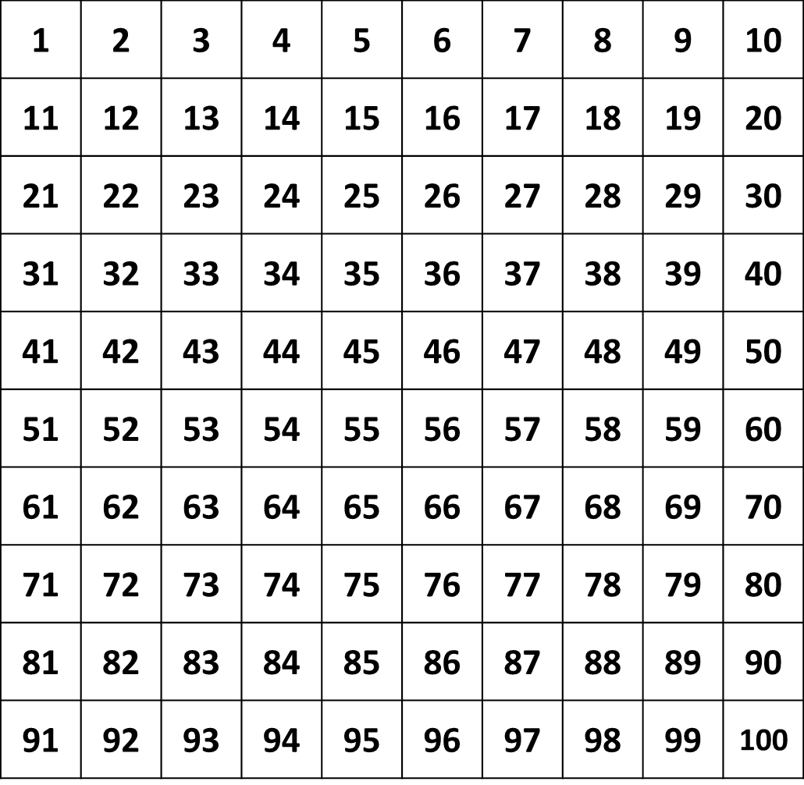
Key End of Y1 Targets:
Count forwards and backwards to/from 100 from any given number.
Given a number identify 1 more and 1 less.
Count in 10’s, 5’s and 2’s.
Write numbers in numerals and words 0-20.
Represent and use number bonds and related subtraction facts within 20

Slide 13
How to support your child’s math’s
Number formation
Counting on and back to/from 100 from different starting points
Recognition of numbers to 100.
Number bonds to 10 and 20 including related subtraction facts
9 + 1 = 10 10 – 1 = 9 13 + 7 = 20 20 – 7 = 13
Counting in multiples of 10’s, 5’s and 2’s
10, 20, 30 …
5, 10, 15 …
2, 4, 6…

Slide 14
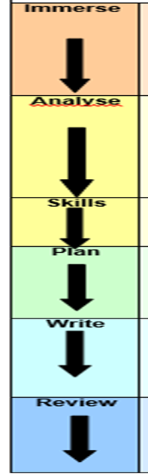
We immerse the children in the book or text type we are using through role play, story telling and drama.
We analyse the features of the text type we are learning about.
Then we teach particular skills the
children will need for that text type.
Then children plan their piece of
writing.
Next children write their piece
before editing and reviewing it.
This is a process we work towards. We do not expect children to do this straight away
Literacy in Y1

Slide 15
How to support your child’s writing
Give a purpose, let them write lists, labels, messages and greetings without copying and praise their attempts at independent writing
Be sensitive and listen to what they say
Talk about their writing
Let them see you writing
Encourage them to feel proud of their work.
Encourage them to ‘have a go’ and take risks.
Read stories and explain or pick out new or interesting vocabulary and phrases.
Help them to learn the spellings of the Year 1 common exception words,

Slide 16
Reading
Shared Reading
We teach the children how to understand a book and a range of comprehension skills. We focus on a book for a half term.
Reading
In small groups we focus on fluency and reading for meaning.
Phonics
Children are taught in small groups to be able to read sounds and apply these skills into their reading. We also teach children about spelling patterns in order for them to use them in their writing independently.

Slide 17
PE
We know the importance of children being active throughout the day. Active children do better in every possible way. They perform better in school and physical activity can increase levels of concentration.
Each week we focus on developing fundamental skills such as ball skills, balance and co-ordination. Children also take part in gymnastics and dance lessons.
We aim to be active throughout the day as children learn best after physical activity. Each day we will do Active 10 challenges. This is 10 minutes of physical activity and can include following a zumba session, a Go Noodle dance routine or playing an active game.

Slide 18
PE
PE days are:
Class 3 – Wednesdays and Thursdays
Class 4 – Mondays and Wednesdays
They will not take place during the first week of term in September.
Children will need to come to school wearing leggings / joggers and a polo shirt type top on PE days. They will also need to wear suitable footwear such as trainers.
No jewellery please - earrings must be taken out not tapped up! If children do wear earrings they must be able to take them out and put them in by themselves.
Long hair to be tied up.
If your child has a verruca they are to wear socks and shoes (trainers or pumps).

Slide 19
Science
In Science we will be learning about the importance of asking questions, gathering evidence, carrying out experiments and looking at different ways of presenting results. Sessions are practical and will focus on the world around us. We cover some of our science learning during Forest School.
Children will be looking at:
Plants
Animals including humans
Everyday materials
More detailed information can be found on the Curriculum Planner that you will receive.

Slide 20
Computing and Online Safety
Children will learn the names of the parts of a computer and what they do. They will learn to create a new word document, save it, name it and reopen it. Children will also learn to create a class algorithm. ‘How to log on to the class computer’
As part of the computing curriculum we teach the children about staying safe online. Children learn how to use technology safely and respectfully, keeping their personal information private. They also learn where to go for help and support if they’re worried about anything they see on the internet or other online technologies. We use a variety of resources including books, stories and websites.
Children who are part of the Stannington Stay Safe team teach the rest of their class how to use the internet safely while they are having fun with it.

Slide 21
PSHE
During our PSHE (personal, social, health and economic education) sessions we cover skills for staying healthy and safe and for behaving well.
Children are given opportunities to show they can take some responsibility for themselves and their environment. They begin to learn about their own and other peoples’ feelings and become aware of the views, needs and rights of others. They will also learn social skills such as how to share, take turns, play, help others, resolve simple arguments and resist bullying.
The children will also take part in ‘Reflect-Ed’ sessions, which help to develop an understanding of metacognition* and build their resilience as learners. These sessions support them with understanding the different ways in which we learn, as well as helping them to reflect on, monitor and manage their own learning. We also focus on Zones of Regulation which helps children to identify how they are feeling, why they are feeling like this and strategies to support them with different emotions.
* Metacognition - a critical awareness of a) one's thinking and learning and b) oneself as a thinker and learner.

Slide 22
RE
As part of RE children develop their knowledge and understanding of principal religions and worldviews. They learn to use subject-specific vocabulary, ask questions and begin to express their own views in response to what they’re taught.
This includes:
Learning about including festivals, places of worship, rituals and ways of life, in order to find out about the meanings behind them.
Retelling and exploring the meanings of some religious and moral stories.
Recognising some of the symbols and actions that express a religious community’s way of life and looking at similarities between them.
We hope to have educational visits to Stannington Church.

Slide 23
Music
During music sessions we focus on developing the children's capacity to listen carefully and respond physically to a wide range of different kinds of music. Your child will play musical instruments and sing a variety of songs from memory, adding accompaniments and creating short compositions. Children also explore the way sounds and silence can create different moods and effects.
In Year 1 children will also learn how to play the recorders! These can be purchased from school for around £5 or you can purchase your own descant recorder.

Slide 24
Theme Weeks
Throughout the year we have theme weeks to support and embed learning for certain subjects.
This year the children took part in:
Art’s Week – the children learnt how to create a collage in the style of Hannah Hock. They looked at the work of Damien Hirst and printed their own designs onto a t shirt.
Healthy week- the children explored all the ways we can stay healthy and made fruit kebabs!

Slide 25
Education Visits
We are hoping to have the following workshops and educational visits but this is only possible if we receive voluntary contributions from families. We have made the decision to have 2 in school workshops as these are likely to be around £5 and one educational visit which may be £20+.
Autumn – Toys workshop in school
Spring – Yorkshire Wildlife Park
Summer – Wonder dome workshop in school

Slide 26
Forest Schools
Forest School will continue, in Year 1 and this takes places in the Spring Term. This will still take place on a Friday. The children will continue to develop their knowledge of the outdoors as well as their scientific and art skills.
They will learn to work in a team and problem solve.

Slide 27
Home Reading
Little and often is the best approach. Children who regularly read at least 3 times a week and are read to on a regular basis make the most progress each year, which is supported by national research. When reading with your child it is important to encourage fluency and questioning of the text.
Children are given a reading diary that we ask you to write in to show when they have read at home. These are handed into school to be marked every week on a Monday
Reading books will be changed on Mondays too. They will get 2 phonetically decodable books (RWInc) which they should practise reading as often as possible. The children will also get a book for pleasure (a coloured book). Children will also have access to the online website Oxford Owl.

Slide 28
Curriculum Planners, Knowledge Builders & Home Learning
Curriculum planners can be found on the school website and google classroom pages. This will provide details of what we will be covering and how you can help your child at home.
Knowledge builders can also be found on the school website and google classroom for Science and Topic for you to look through and discuss with your child.
Maths and spelling homework will be put on Google Classroom each Monday and is to be handed in the following Monday. You can hand in the purple home learning book to be looked at or submit it online via Google Classroom. Please complete this as it consolidates the learning in school. This is in addition to the expectation that children read at home at least 3 times per week.
Please see the following slides for examples.

Slide 30
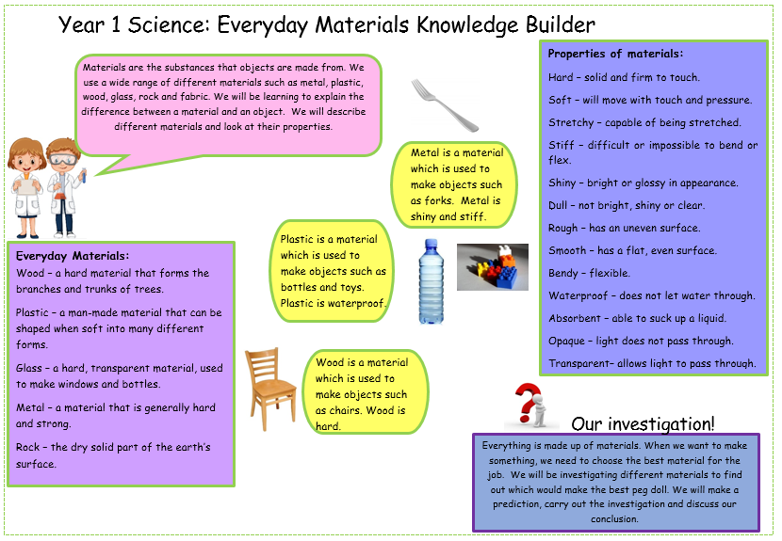

Slide 31
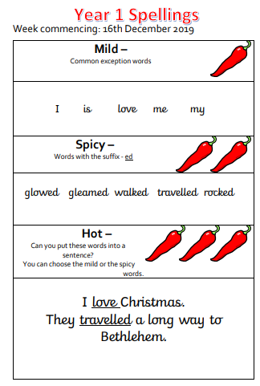
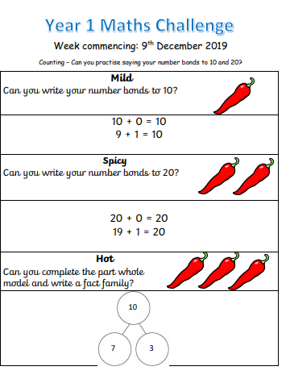

Slide 32
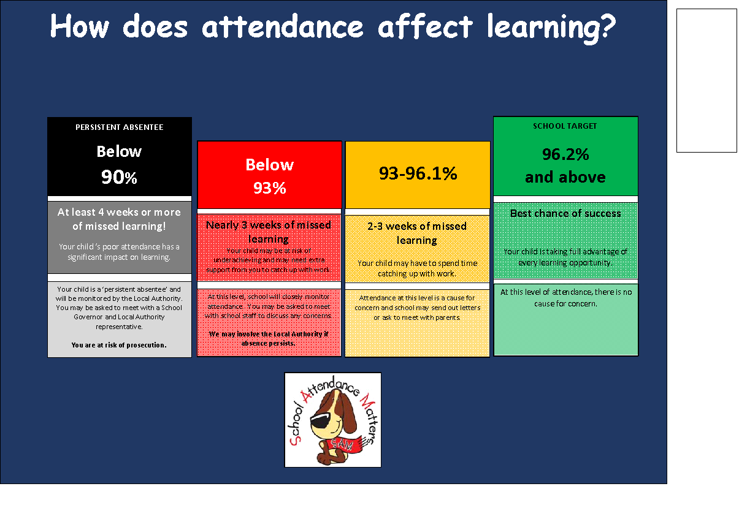
Attendance

Slide 33
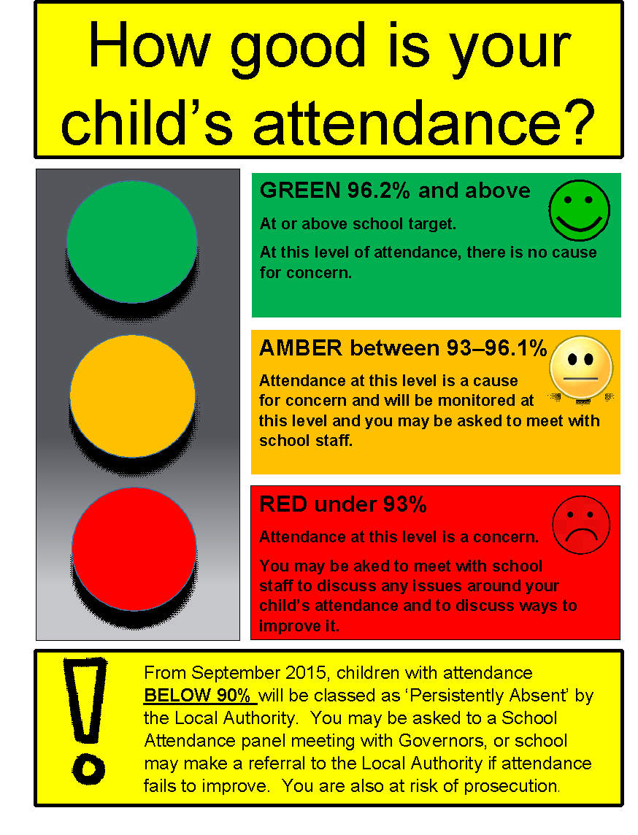

Slide 34
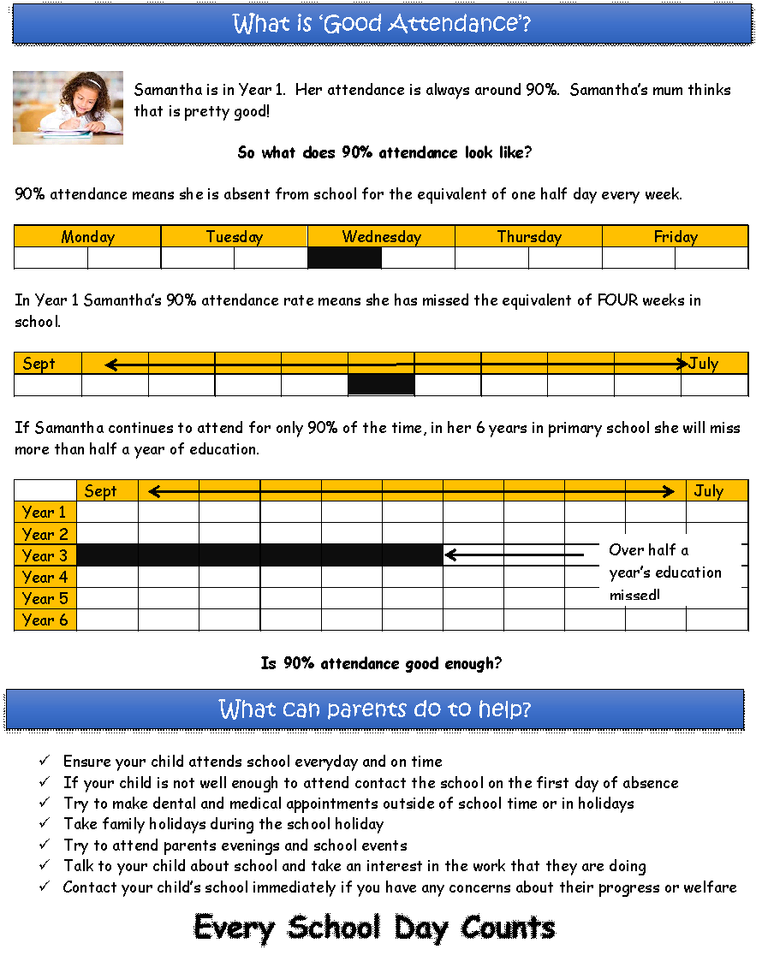

Slide 35
Reminders…
Please put your child’s first name and surname in all their belongings. This is very important!
If you think your child may need a change of clothes for any reason please either send a named bag to school which can stay on their peg, or put clothes in their book bag.
Help your child to learn their purple mash password so that they can log in independently.
Arrive at school on time at 8:40 so that children feel settled and ready to learn. We always have a busy exciting day planned and need to get started straight away.
If someone other than yourself is collecting your child please email or speak to the class teacher. If this is on a regular basis please let the class teacher know in September.

Slide 36
We know that there is a lot of information here. If you have any questions or queries please feel free to email us.
Class 3 -
lhowell@stannington.sheffield.sch.uk
Class 4 -
stravis@stannington.sheffield.sch.uk
We look forward to working with your children in September!

