Slide 1
Read Write Inc. at Stannington Infant School

Slide 2
What is Read Write Inc?
Read Write Inc. is a synthetic phonics programme designed to help children learn to read quickly and fluently by introducing them to sets of sounds at a time. Then they apply these sounds to the books they are reading before leaning a new set of sounds.
We also read a range of books to the children in class so they are exposed to all the sounds within the English Language.
Notes:
Read as it is

Slide 3
Pure Sounds
We will teach the children how to say ‘pure sounds’ and this can be difficult for us as adults as we may not be used to saying ‘m’ instead of ‘muh’.
Notes:
Read it as it is – this will go on the school website and you will be able to watch this video in full. Model saying ‘l’ as ‘ull’ not luh, r as ‘rr’ not ‘ruh’

Slide 4
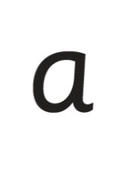
sat
p
mat
d
sad
i
t
n
Notes:
Click 1 – we teach the children to read sets of sounds to begin with
Click 2 – when they can read them we teach them to blend them to read simple words
Click 3 – when they can do this we teach them to read the words in books – these are the books your child will bring home as their home reading book – we call it a phonetically decodable book.

Slide 5
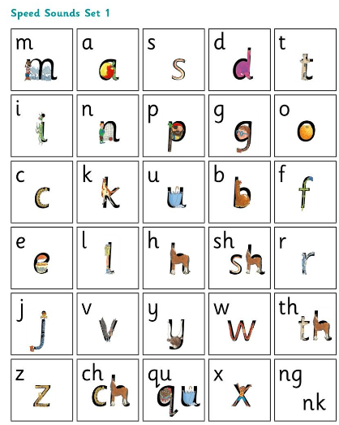
Speed Sounds
We teach the children sets of words.
They are called speed sounds as
they learn to read then on sight.
Notes:
Read this as it is

Slide 6
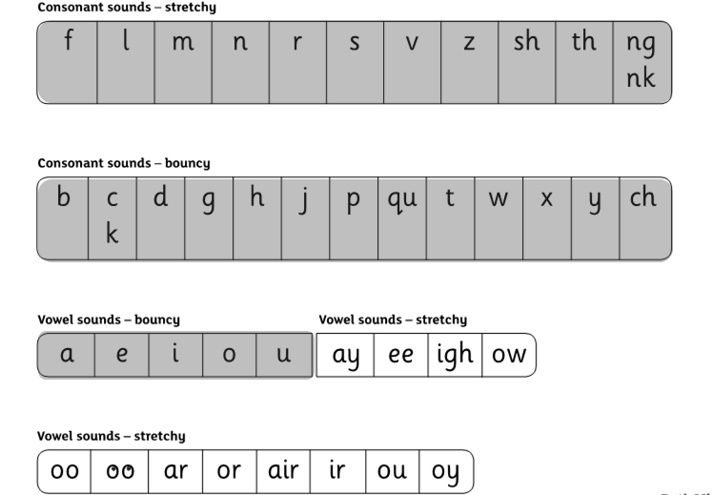
Set 1 Speed Sounds
We teach Set 1 first (the shaded sounds).
We use an approach known as Fred Talk using flash cards with the sounds on them.
Notes:
Read this as it is

Slide 7
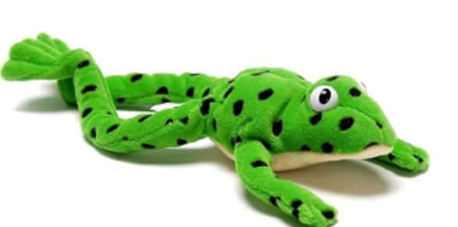
Fred Talk
This is Fred.
He is a frog who can only speak in sounds, and we call this Fred Talk.
My Turn, Your Turn
Notes:
Play my turn your turn with Set 1 cards – tell parents the rhyme as well.

Slide 8
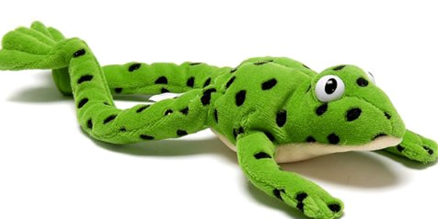
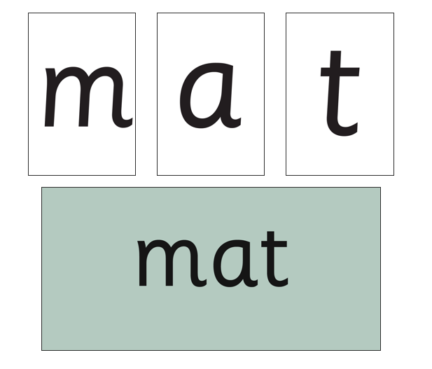
Using Fred Talk to blend
Once the children know the pure sounds, we teach them to blend sounds to read words.
My Turn, Your Turn
Notes:
Play my turn your turn with Set 1 word cards for simple words –

Slide 9
Set 2 Speed Sounds
We teach Set 2 next (the unshaded sounds).
Notes:
Read this as it is

Slide 10
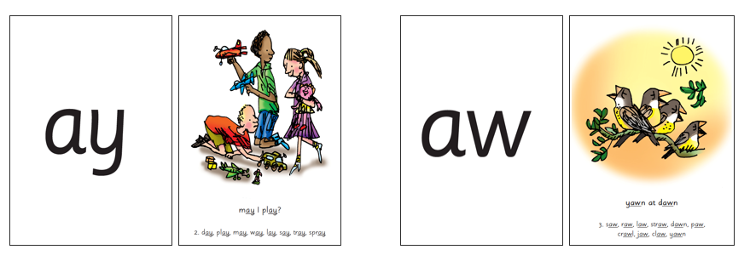
Set 2 Speed Sounds
Notes:
Play my turn your turn with Set 2 cards – tell parents the rhyme as well.
Explain that we call diagraphs where there are two letters for one sound special friends and ask children to look for them within words.

Slide 11
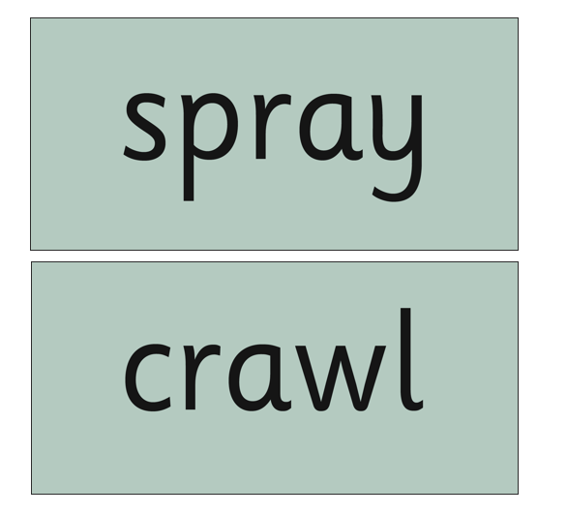
Using Fred Talk to blend
Once the children know the sounds, we teach them to read them in words.
My Turn, Your Turn
Notes:
Play my turn your turn with Set 2 word cards for simple words – children will be asked to spot the special friend.

Slide 12
Fred in your Head
To help the children to become more fluent we use ‘Fred in your Head’
Notes:
Play Fred in your Head with parents using a set of green words.

Slide 13
Red Words
Some words are ‘tricky’ because they contain letters that don’t match the sounds the child has been taught.
For example, ‘said’ has ‘ai’ making an ‘e’ sound.
We call
these read words.
Notes:
Read as it is and remind parents we call them ‘red’ words.

Slide 14
Fred Fingers
To help children to spell we use Fred Fingers.
Notes:
Show children how to use Fred Fingers – ask them to spell a few words using Fred Fingers

Slide 15
Reading Books
Your child will bring home a book that is matched to their phonics learning. It may have a shiny front cover or a paper front cover.
We call these phonetically decodable books and your child should be able to read or decode all the words within it.

Slide 16
Useful resources for parents:
https://home.oxfordowl.co.uk/reading/reading-schemes-oxford-levels/read-write-inc-phonics-guide/
https://www.stanningtoninfants.co.uk/english-2/
How to say sounds video

Slide 17
Any questions?

