Slide 1
End of Key Stage 1 assessment 2023

Slide 2
How do we assess the children?
Children are assessed throughout the year using teacher assessment.
At the end of Year 2 all parents will be told whether their child is working towards or at the expected standard for the end of Key Stage 1.
This decision will be reached using a combination of a numerical score for each test alongside teacher assessment.
If we assess your child to be working at greater depth within the expected standard we will share this with you verbally.

Slide 3
How are the children assessed?
The children will take part in tests for:
Reading
Grammar, punctuation and spelling (optional)
Mathematics
Writing and science will be assessed through teacher assessments.
All tests will be completed during May 2023

Slide 4
Reading assessments
There will be two papers
1 with text and questions combined
1 containing a more challenging text with questions in a separate booklet.
All children will be given the opportunity to sit both papers.

Slide 5
Reading paper examples
Ants are insects that you can often see in a garden, in a park or just on the pavement. They usually live underground.
What kind of animal is an ant?
_________________________
Find and copy two places you might see ants.
1. __________________
2. __________________

Slide 6
The Blackbird and his Wife
One day the king was passing and he heard the two birds singing. He said to his servants, “Catch those birds! I will keep them in a silver cage and they will sing to me.” So the servants set a trap, but they only caught one of the birds: the blackbird’s wife. They put her into a silver cage and hung her over the king’s bed. But she was so sad that she wouldn’t sing at all.
Questions 1 – 8 are about The Blackbird and his Wife (pages 4 – 7)
Why did the king want to have the blackbirds? (page 4)
Why was the blackbird’s wife sad? (page 4)

Slide 7
Grammar, punctuation and spelling
This paper will focus on their knowledge of technical aspects of grammar.
We teach this to the children as part of our literacy teaching sequence so that they are familiar with the terminology but also able to use it in their own writing.
Add two letters to the word happy to make a word that means not happy.
We went to a football game. Our team lost and I was
__happy.
Circle the verb in the sentence below:
  Lisa sticks all the pictures in her big scrapbook.

Slide 8
Example grammar, punctuation and spelling questions
Write one word on the line below to complete the sentence in the past tense.
I __________ to Scotland during the school holidays.
Write the missing punctuation mark to complete the sentence below.
Can you play my favourite tune ___
Circle the three nouns in the sentence below.
A whale has an enormous heart that can weigh as much as a small car.

Slide 9
Maths assessment
There will be two papers:
  A reasoning paper where children will have to solve a range of written and pictorial problems and calculations. Children will be able to use a ruler during this paper.
  An arithmetic paper where children will be given a range of calculations to answer in their booklet. They will not be able to use a ruler during this paper.

Slide 10
Example maths questions: Arithmetic
5 + 7 =
19 – 9 =
36 + 24 =
15 + 3 + 3 =
_ + 5 = 9
36 + 24 =
50 - __ = 20

Slide 11
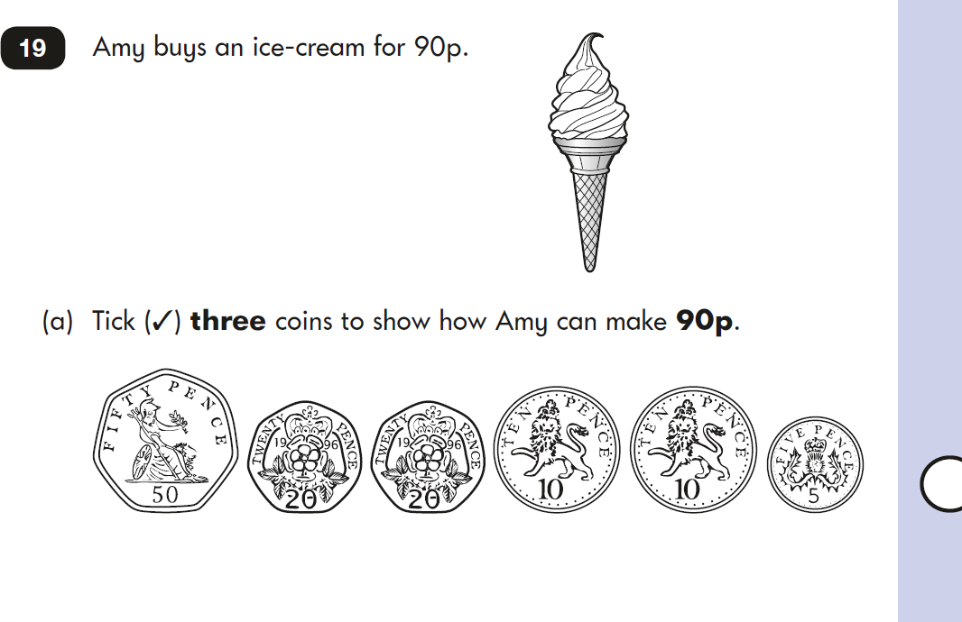
Example maths questions: Reasoning

Slide 12
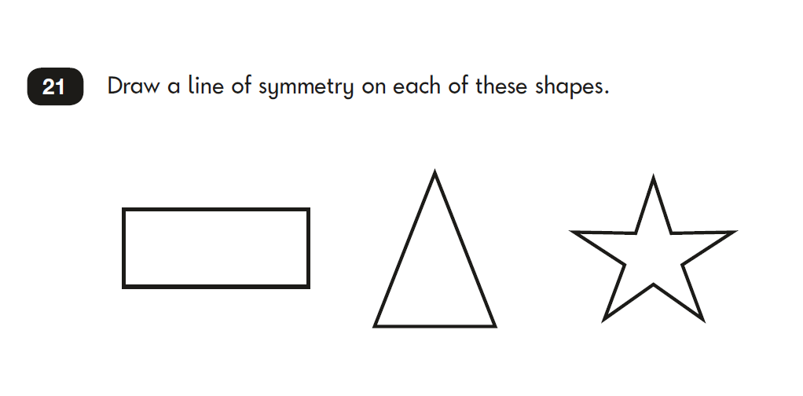

Slide 13
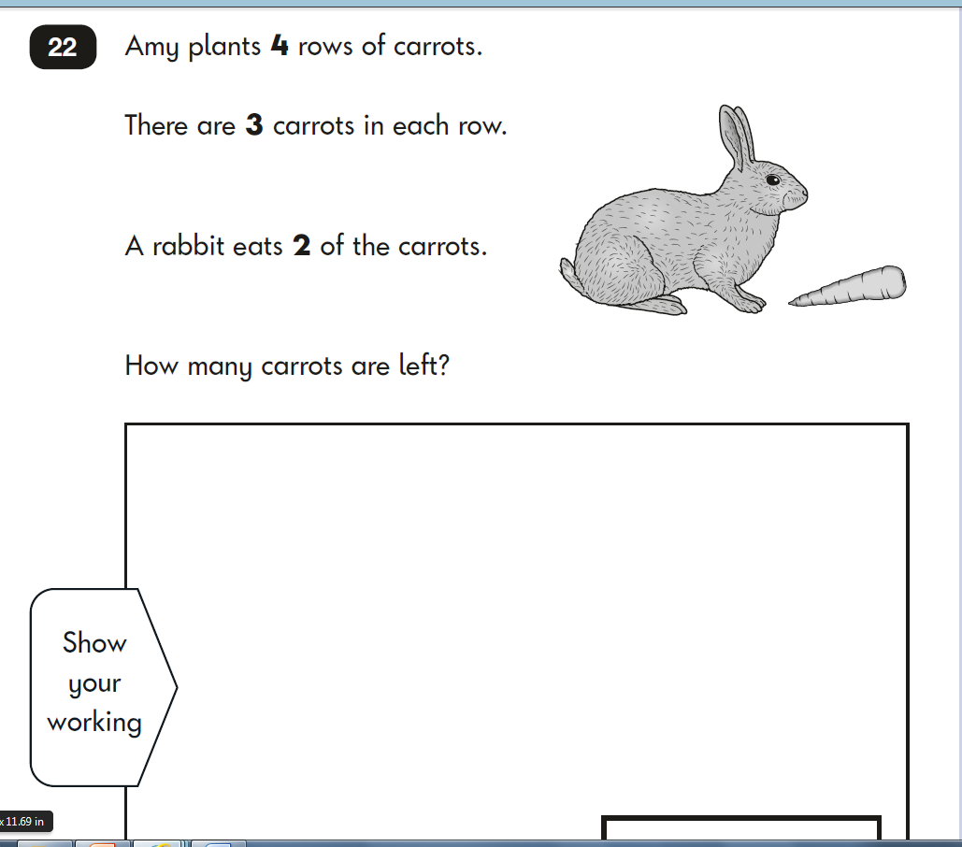

Slide 14
Marking/scoring the tests
Each test will be marked in school by the class teacher.
This will then be converted to a ‘scaled score’.
Children scoring 100 or more will have met the ‘expected standard’ of the test.
Children scoring below 100 will not have met the expected standard of the test.

Slide 15
Writing assessment
There isn’t a test for writing.
Children’s work is assessed throughout the year by the class teacher. Teachers will decide if children are working towards or at the expected standard for the end of Year 2.

Slide 16
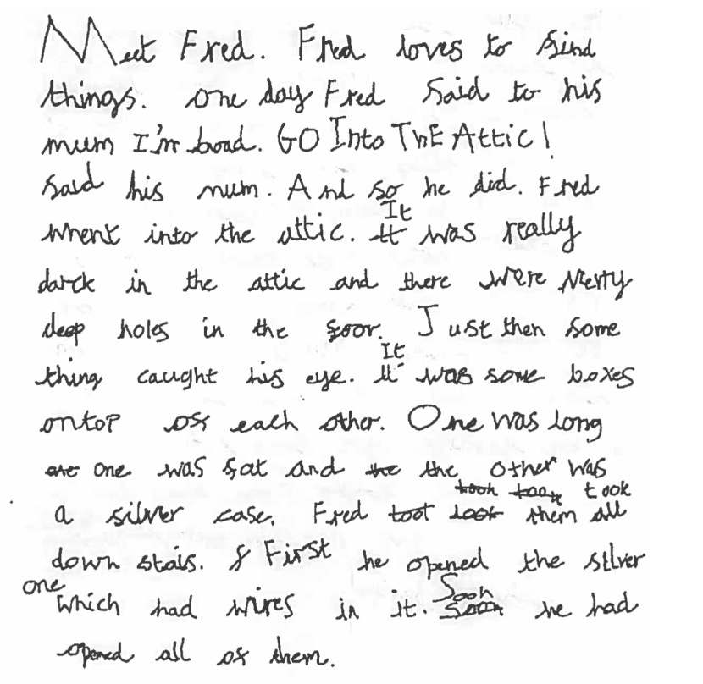
What does the expected standard look like?

Slide 17
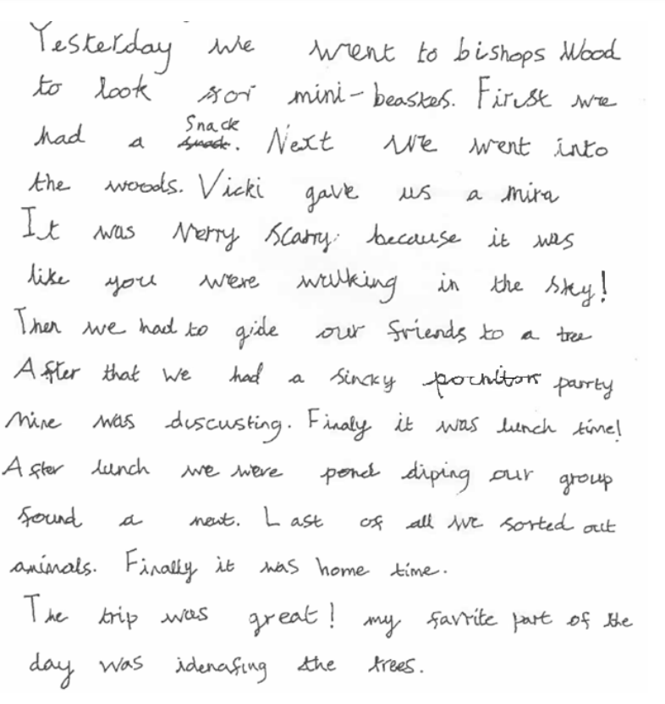

Slide 18
Teacher Assessment
Throughout the year children are assessed by the class teacher in reading, writing and maths.
We assess the children using assessments based on the Sheffield STATS assessment tool.
We will use the test scores and our teacher assessment to make a final decision about whether your child is working at or below the expected standard.

Slide 19
Any questions?

