Slide 1
Healthy Minds Champions Assembly
Welcome to the…

Slide 2
What is our assembly about?
We want to introduce ourselves, the new Healthy Minds Champions
Tell you about an exciting school project we are all going to do!
Notes:
Insert pictures and names into slide

Slide 3
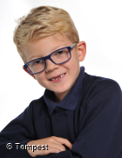
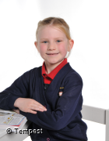
The Healthy Minds Champions
Notes:
Insert pictures and names into slide

Slide 4
What are Healthy Minds Champions?
We want to make school feel like a safe, friendly and helpful place for everyone!

Slide 5
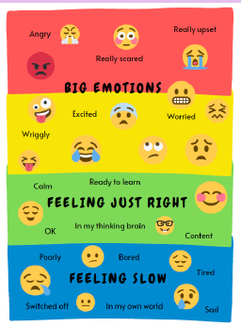
How can the Healthy Minds Champions help you ?
We help with feelings and emotions!
We all feel big emotions sometimes, so we are here to help you bounce back into the green zone.

Slide 6
Why do we want to be Healthy Minds Champions?
“ I want to be a Healthy Minds Champion because…”

Slide 7
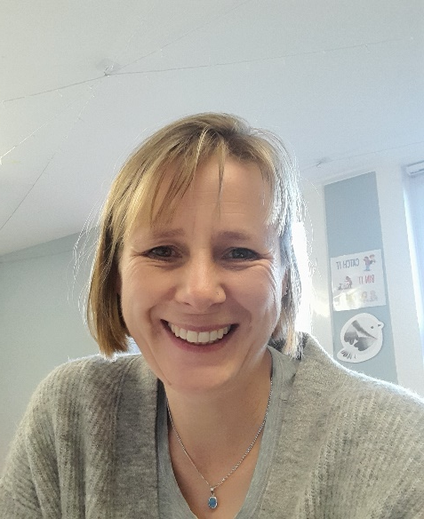
We work with…
Angela Manning
Our school’s EMHP
Mrs Billingsley
Our school’s Mental Health Lead
&

Slide 8
The Healthy Minds Champions Projects so far
Together our school made an Emotions Tree! Do you remember?
It is displayed in the hall for everyone to see.

Slide 9
Our Emotions Tree
Like normal trees, it has lots of different leaves, but this tree helps us to think about our emotions!
It is a way to help us share our feelings and remind us that all emotions are ok!

Slide 10
Our Emotions Tree
It is based on the emotion colour zones we already use in school.
We chose four branches:
Making friends
Listening to others
New Classes
Learning New Things

Slide 11
Our Brain Break videos
Last year the Healthy Minds Champions made brain break videos to help us to be energised or calm.
Ask your teacher if your class can use a class calming or energising video
Let’s try the ‘Rain on your Head’ video!

Slide 12
Our big, exciting Healthy Minds Project this year is………
To make our school garden a safe and better place to play at playtimes
We are making some posters to help you follow the rules and have a happy time in the school garden.
We can’t wait to show you our posters!

Slide 13
Thank you for listening!
We hope you have a nice day

