Slide 1
Welcome to Year 1
2nd July 2024

Slide 2

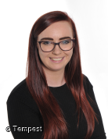
The Y1 Team
Teachers
Class 3 Mrs Cann
Class 4 Miss Travis

Slide 3
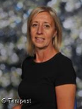
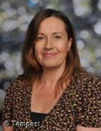
Teaching Assistants
Class 3 -Miss Woodhead Class 4 – Mrs Leaf
Mrs Leaf and Miss Woodhead are classroom based teaching assistants.

Slide 4
The aim of this PowerPoint is to provide you with as much information as we can about Year 1. We know that many of you will have no experience of what happens in Year 1 and what the children will be doing.
On Thursday 5th and Monday 9th September after school there will be an opportunity to come into classes after school.

Slide 5
A Typical Day
Children will have access to some continuous provision, for the first half term. The following slides explain what a typical day in Year 1 looks like and we aim to work towards this as the children come in to school.
The school day starts at 8:50 and finishes at 3:20. The children will need to arrive and line up on the playground outside the mobile classrooms from 8.40am please.

Slide 6
Mornings
Morning Work - short simple task as the children come in.
Literacy- small group work
Numeracy- small group work
Phonics - Daily
It is important that you arrive on time for the doors opening at 8:40. The morning work allows children to settle in and for staff to check in with the children as well as complete the dinner register and travel tracker.

Slide 7
Afternoons
Shared Reading
Reading 1:1 or in small groups
Handwriting
Maths Facts session
Topic Work –
History/Geography/Art/D&T
Science
PSHE
RE
PE
Music/Singing
Computing

Slide 8
Morning Routines
Children will need their book bag and water bottle every day.
Children will be greeted outside by their class teacher and enter the mobile where the Teaching Assistant will be inside to greet them.
There will be a morning work activity for the children to do as they come in.
We want the children to be as happy and independent as possible. Please send your child in Velcro shoes / trainers if they cannot tie laces and ensure they are able to put on and fasten up their own coat. Obviously we are here to help if needed but it is easier and better for the children if they can do these things themselves.

Slide 9
Maths in Y1
Autumn Term
Number and Place Value
(within 10)
Addition and Subtraction
(within 10)
Shape
Spring Term
Number and Place Value
(within 20)
Addition and Subtraction
(within 20)
Number and Place Value
(within 50)
Length and Height
Capacity and Volume
Summer Term
Mass and Weight
Multiplication
and Division
Fractions
Position and Direction
Number and Place Value
(within 100)
Money and Time

Slide 10
Maths in Y1
There is a strong emphasis on developing instant recall of number facts.
These are called KIRFs (Key Instant Recall Facts).
Autumn 1 | Recall addition and subtraction of 1 within 10. (i.e. 4 + 1 and 6 – 1))
Autumn 2 | Recall addition and subtraction of 2 within 10. (i.e. 5 – 2 and 7 + 2)
Spring 1 | Recall addition and subtraction of 3 within 10. (i.e. 5 – 3 and 8 - 3)
Spring 2 | Recall all the addition and subtraction bonds to 10. (i.e. 4 + 6 and 10 - 1)
Summer 1 | Recall doubles and halves to 10. (i.e. 2 + 2 and 4 + 4)
Summer 2 | Recall near doubles and halves to 10. (i.e. 4 + 3 and 5 + 4)
Number formation | Correctly form digits 6-9

Slide 11
Steps of learning
The children are introduced to new concepts in a three stage approach (C-P-A) to help scaffold their learning.
The children may go back a forth in this process.
Concrete
‘doing’
The children begin by using objects to help them learn in a more familiar way.
Pictorial
‘seeing’
The children then use models and images to help them make links.
Abstract
‘symbolic’
Finally the children move onto use just numbers and abstract symbols.
The way we teach maths is the same across the whole of KS1
Notes:
The way we teach maths is the same across the whole of KS1 ie the CPA

Slide 12
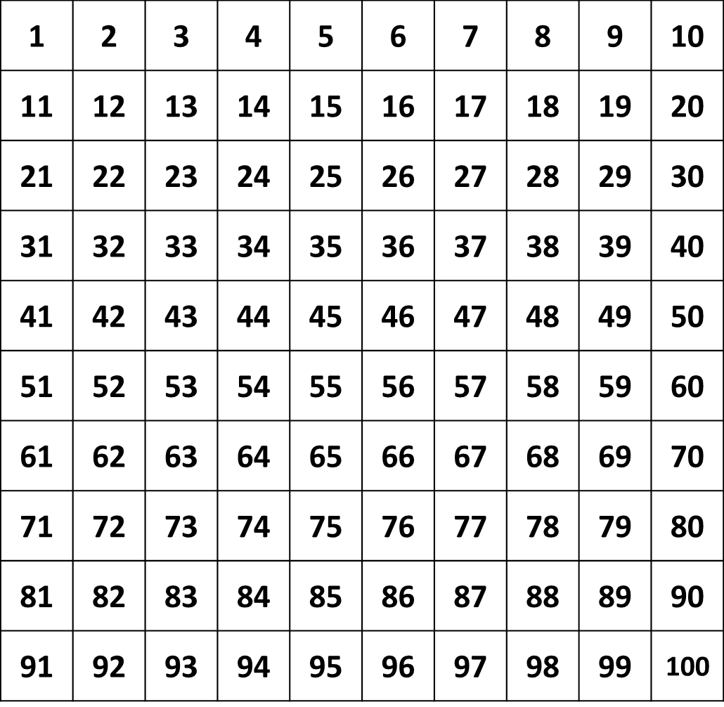
Key End of Y1 Targets:
Count forwards and backwards to/from 100 from any given number.
Given a number identify 1 more and 1 less.
Count in 10’s to 100, 5’s to 50 and 2’s to 20.
Write numbers in numerals and words 0-20.
Instant recall of number bonds and related subtraction facts within 10 e.g 8 + 2 = 10
10 – 2 = 8

Slide 13
How can I support my child’s math's learning?
Number formation 0 - 9
Counting reliably
Counting forwards and backwards to/from 100 from different starting points
Recognition of numbers to 100.
Instant recall facts
Number bonds to 10 including related subtraction facts
9 + 1 = 10 10 – 1 = 9
Counting in multiples of 10’s, 5’s and 2’s
10, 20, 30 …
5, 10, 15 …
2, 4, 6…

Slide 14

We immerse the children in the book or text type we are using through role play, story telling and drama.
We analyse the features of the text type we are learning about.
Then we teach particular skills the
children will need for that text type.
Then children plan their piece of
writing.
Next children write their piece
before editing and reviewing it.
This is a process we work towards. We do not expect children to do this straight away
Literacy in Y1

Slide 15
How can I support my child’s literacy learning?
Give a purpose, let them write lists, labels, messages and greetings without copying and praise their attempts at independent writing
Be sensitive and listen to what they say
Talk about their writing
Let them see you writing
Encourage them to feel proud of their work.
Encourage them to ‘have a go’ and take risks.
Read stories and explain or pick out new or interesting vocabulary and phrases.
Help them to learn the spellings of the Year 1 common exception words.

Slide 16
Reading in Y1
Shared Reading
We teach the children how to understand a book and a range of comprehension skills such as inference and prediction. We focus on a book for a half term.
Reading
In small groups we focus on fluency, expression and reading for meaning.
Phonics
Children are taught in small groups to be able to read sounds and apply these skills into their reading. We also teach children about spelling patterns in order for them to use them in their writing independently.

Slide 17
PE in Y1
We know the importance of children being active throughout the day. Active children do better in every possible way. They perform better in school and physical activity can increase levels of concentration.
Each week we focus on developing fundamental skills such as ball skills, balance and co-ordination. Children also take part in gymnastics and dance lessons.
We aim to be active throughout the day as children learn best after physical activity. Each day we will do Active 10 challenges. This is 10 minutes of physical activity and can include following a zumba session, a Go Noodle dance routine or playing an active game.

Slide 18
PE days are:
Class 3 – Tuesdays and Thursdays
Class 4 – Mondays and Tuesdays
They will not take place during the first week of term in September.
Children will need to come to school wearing leggings / joggers and a polo shirt type top on PE days. They will also need to wear suitable footwear such as trainers.
No jewellery please - earrings must be taken out not taped up! If children do wear earrings they must be able to take them out and put them in by themselves.
Long hair to be tied up.
If your child has a verruca they are to wear socks and shoes (trainers or pumps).

Slide 19
Science in Y1
In Science we will be learning about the importance of asking questions, gathering evidence, carrying out experiments and looking at different ways of presenting results. Sessions are practical and will focus on the world around us. We cover some of our science learning during Forest School.
Children will be looking at:
Everyday materials
Animals including humans
Plants

Slide 20
Theme Weeks
Throughout the year we have theme weeks to support and embed learning for certain subjects.
This year the children took part in:
Art’s Week – the children learnt how to print and create a clay sculpture in the style of different artists.
Healthy week - the children explored all the ways we can stay healthy and made fruit kebabs!

Slide 21
Educational Visits
We are hoping to have the following workshops and educational visits but this is only possible if we receive voluntary contributions from families.
Autumn – Toys workshop (in school)
Spring – Yorkshire Wildlife Park
Summer – Wonderdome (in school)

Slide 22
Forest Schools in Y1
Forest School will continue, in Year 1 and this takes places in the Spring Term. This takes place all day on a Friday. The children will continue to develop their knowledge of the outdoors as well as their scientific, DT and art skills. They will learn to work in a team and problem solve.

Slide 23
Home Reading
Little and often is the best approach. Children who regularly read at least 5 times a week and are read to on a regular basis make the most progress each year. When reading with your child it is important to encourage fluency and questioning of the text.
Children are given a reading diary that we ask you to write in to show when they have read at home. These are handed into school to be marked every week on a Monday
Reading books will be changed on Mondays too. Children will only get new books if old ones are returned into their tray. They will get 2 phonetically decodable books (RWInc) which they should practise reading as often as possible. The children will also get a book for pleasure (a coloured book). Children will also have access to the online website Oxford Owl.

Slide 24
Curriculum Planners, Knowledge Builders & Home Learning
Curriculum planners can be found on the school website and google classroom pages. This will provide details of what we will be covering and how you can help your child at home.
Knowledge builders can also be found on the school website and google classroom for Science and Topic for you to look through and discuss with your child.
Spelling and maths home learning will be put on Google Classroom each Monday. This can be completed in their home learning books and handed in on a Monday. We will also be doing weekly practice of number formation, counting and spelling quizzes and half termly maths fact quizzes with the children.
Please practise with your child as it consolidates the learning in school.

Slide 25
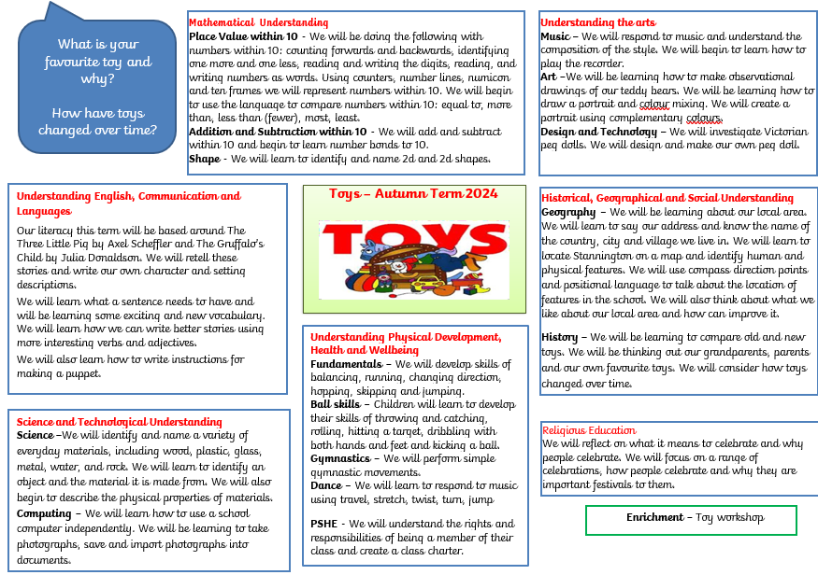

Slide 26
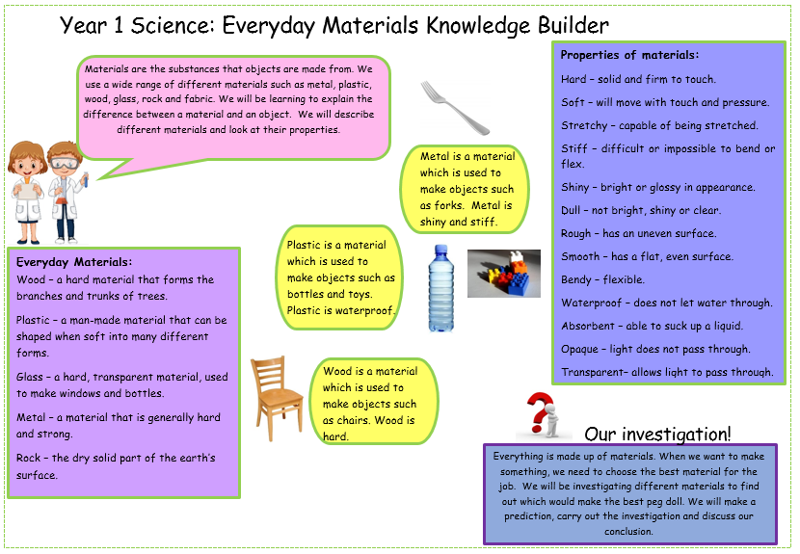

Slide 27
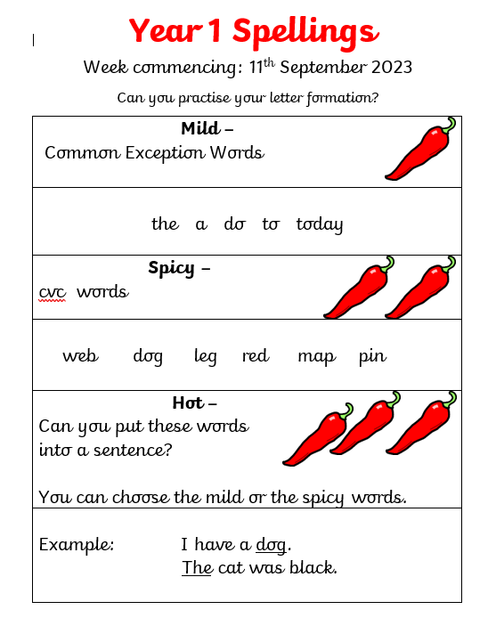
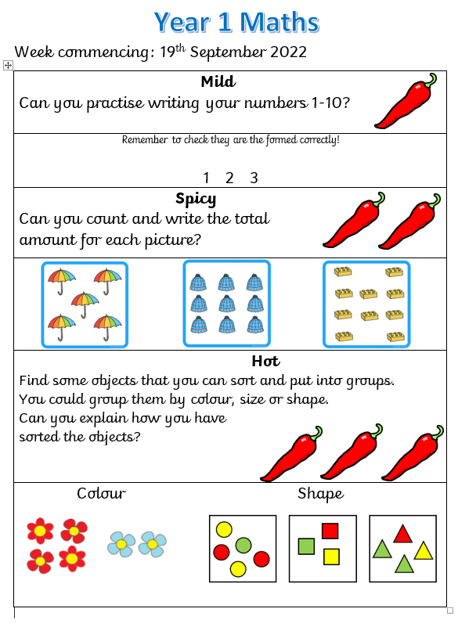

Slide 28
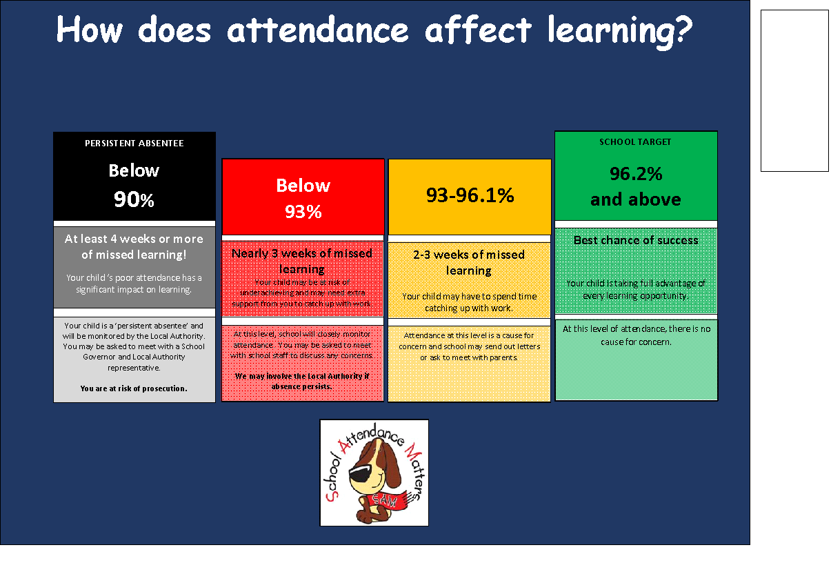
Attendance

Slide 29
Reminders…
Please put your child’s first name and surname in all their belongings. This is very important!
If you think your child may need a change of clothes for any reason please either send a named bag to school which can stay on their peg, or put clothes in their book bag.
Arrive at school on time at 8:40 so that children feel settled and ready to learn. We always have a busy exciting day planned and need to get started straight away.
If someone other than yourself is collecting your child please email or speak to the class teacher. If this is on a regular basis please let the class teacher know in September.
Please encourage your child to be independent where possible for example zipping up their own coat or fastening their shoes.

Slide 30
We know that there is a lot of information here. If you have any questions or queries please feel free to email us.
Class 3 -
acann@stannington.sheffield.sch.uk
Class 4 -
stravis@stannington.sheffield.sch.uk
We look forward to working with your children in September!

