Slide 1
Readiness to Write at Stannington Infant School
Getting Ready to Write

Slide 2
Why handwriting?
The relevance of handwriting is sometimes questioned in a day and age when we are surrounded by laptops, iPads and smart phones. But the teaching of handwriting is just as important now as it ever has been. The need to create something of beauty never leaves the human brain and nothing beats that feeling of personal triumph when we look at something we have completed ourselves.

Slide 3
Getting Ready to Write……
Pick up the paper bag!!!!
Stand up
Hold your arm at shoulder height
Scrunch the paper bag into as small a ball as you can.
Now unfold it using only that hand without lowering your arm.

Slide 4
Core Strength and Shoulder Girdle
These two things are key in preparing children to write.
Things to strengthen these areas:
hanging from monkey bars
climbing
pushing and pulling
weight baring – carrying/holding heavier things

Slide 5
Core Strength and Shoulder Girdle
Developing these two areas of strength can also help with
Postural Control
To be able to write children need to be able to maintain their posture or writing position for short periods of time, longer as they go through school.
Can your child sit and write for a few minutes at a time with a straight back?
Can they lay on the floor for a period of time and write or colour?

Slide 6
Junk Modelling/Wood Work
Develops gross and fine motor skills
Develops dexterity
Problem solving
Cutting skills
Sticking skills
All of the above help to develop the skills and strength needed for writing.

Slide 7
Other things to know and try ….
Palmer Reflex
Being able to hold your hand open when doing round and round the garden helps children prepare to be able to hold a pencil.
If they react by closing their hand, keep practising until they no longer do this.
Can your child move both arms independently of each other?
Can they make an anti clockwise circle with one arm and a clockwise one with the other?
All of the above help to develop skills and strength needed for writing.

Slide 8
Things to do over the summer….
Drawing lines starting at the top and go down.
  (l, i, h, t, b all start at the top)
Draw circles anti clockwise
  (o,a,c and d all start from an anti clockwise direction)
Zig Zag
  (down then up like a w, v or x)

Slide 9
Words you will hear your children saying about letters:
  tall letters (b d h k l )
  short letters (a c e i m n o r s u v w x z)
  tail letters (g j p q)
  teenager t (3/4 letter)
  greedy letter (f)

Slide 10
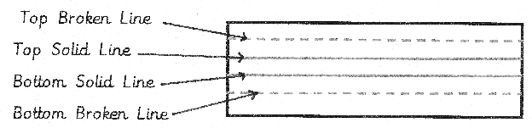
Language of handwriting

Slide 11
Language of handwriting
BBC – bottom to back of chair
TNT – tummy near table
6 feet on the floor
2 hands on the table

Slide 12
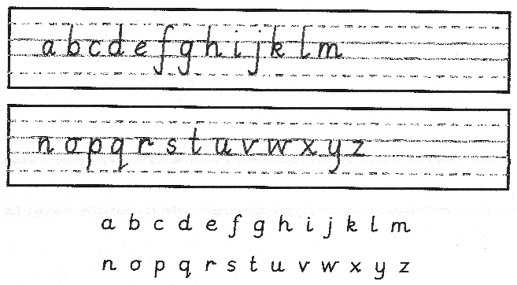
What is our handwriting style?

Slide 13
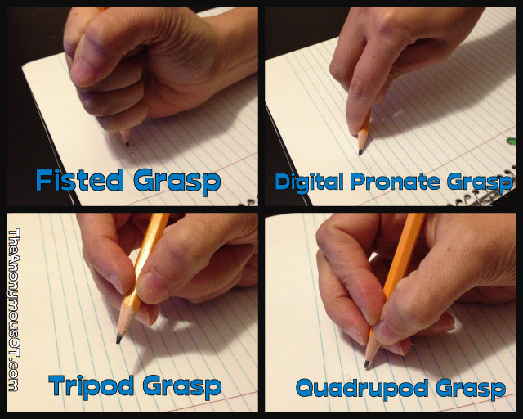
Welcome Pinchy Parrot!
Tripod grasp/grip
3 fingers gripping the pencil - one
thumb, two fingers,
pencil ‘sits back in his pillow’/ back
in his bed’.
1 cm of the yellow/black showing,
2 -3cm if left handed

Slide 14
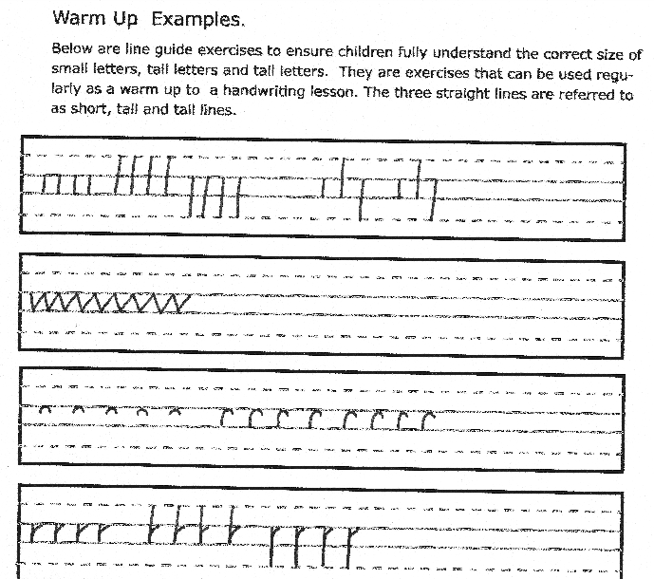

Slide 15
How do we teach handwriting?
We introduce letters a family at a time.

Slide 16
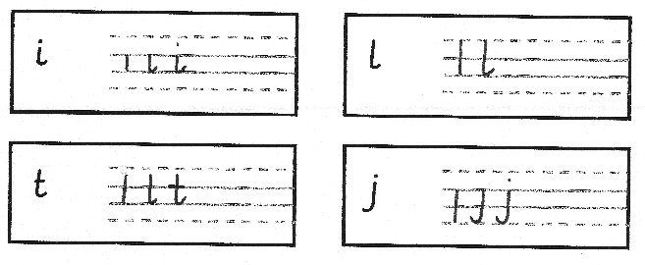
Straight line family

Slide 17
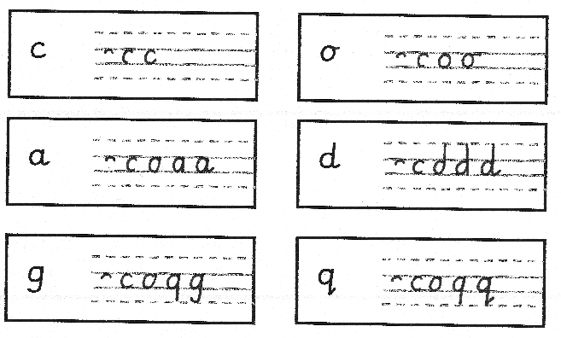
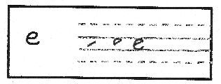
Coathanger family

Slide 18
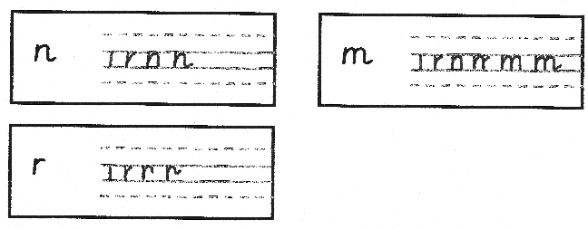
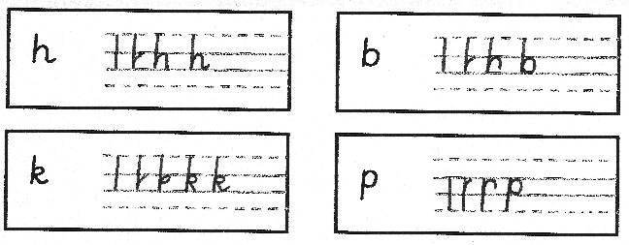
Bridge family

Slide 19
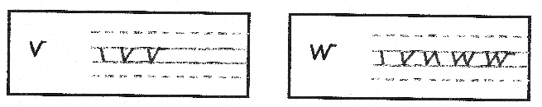
Zig Zag family

Slide 20
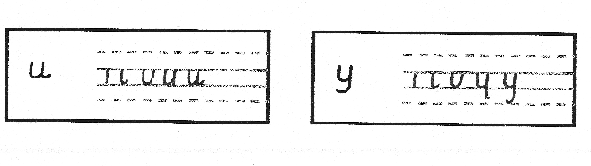
Smile family

Slide 21
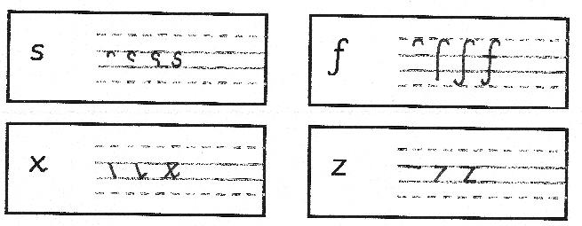
Misfits family

Slide 22
Next steps
When children can form all the letters correctly we move onto teaching children how to join.
As children's letter formation improves they move to narrower lines.
Once children don’t need to use the lined paper we move on to plain paper books with line guides. (This is in Year 2)

Slide 23
Questions?
Thank you for your time.

