Slide 1
Reading at Stannington Infant School
Read Write Inc. Phonics

Slide 2
School Readiness – Getting Ready to Read
Before children learn to read sounds and words they need to be able to listen for sounds.
There are lots of things you can do at home to support this.
Notes:
Read as it is

Slide 3
Rhymes and Songs
Rhymes/Rhyming Stories –
Twinkle Twinkle Little Star The Gruffalo
Repetitive songs and rhymes
Wind the Bobbin Up Head, Shoulders, Knees and Toes
Humpty Dumpty BINGO Wheels on the Bus
Notes:
Read as it is

Slide 4
Stories, Clapping and Alliteration
Stories –
Listening to stories
Clapping Sounds
Clap their name
Clap sounds in a word
Alliteration Games
Liz loves lollies
Harry hides honey
Connie can cartwheel
Sam shares sweets
Notes:
Read as it is

Slide 5
Preparing to read a word or a book
Tracking
Children need to be able to track from left to right with their eyes and head when they read.
Crossing the Midline
Touch your ear with the opposite hand
Touch your knee with your opposite hand.
Notes:
Read as it is

Slide 6
Quiet times
Do you leave the TV or the radio on when you are in the house.
Do you go for a walk with your iPods/earphones in?
Do you go to sleep listening to a Podcast/music/audio book?
Quiet is important for all of us.
Having quiet times within your day is helpful for you and your children to tune in with the world around.
Notes:
Read as it is

Slide 7
Reading at Home
Reading at home is vital.
Sharing a physical book with your child is such an important part of their reading journey. Learning how to turn a page themselves, tracking text as you read it and hearing your voice as you read has the biggest impact on children.
Please do this as often as you can, even when it is tempting to put an audio book on or turn on the TV.
Notes:
Read as it is

Slide 8

What is Read Write Inc?
Read Write Inc. is a synthetic phonics programme designed to help children learn to read quickly and fluently by introducing them to sets of sounds at a time. They then apply these sounds to the books they are reading before leaning a new set of sounds.
We also read a range of books to the children in class so they are exposed to all the sounds within the English Language.
Notes:
Read as it is

Slide 9

Pure Sounds
We will teach the children how to say ‘pure sounds’ and this can be difficult for us as adults as we may not be used to saying ‘m’ instead of ‘muh’.
Notes:
Read it as it is – this will go on the school website and you will be able to watch this video in full. Model saying ‘l’ as ‘ull’ not luh, r as ‘rr’ not ‘ruh’

Slide 10



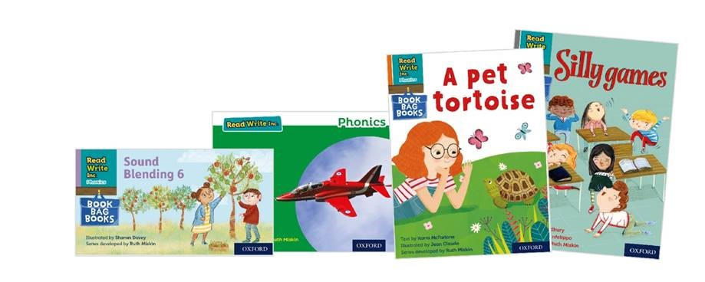
sat
p
mat
d
sad
i
t
n
Notes:
Click 1 – we teach the children to read sets of sounds to begin with
Click 2 – when they can read them we teach them to blend them to read simple words
Click 3 – when they can do this we teach them to read the words in books – these are the books your child will bring home as their home reading book – we call it a phonetically decodable book.

Slide 11
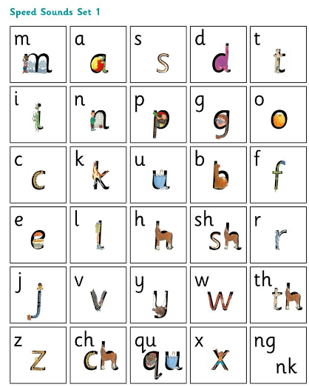
Speed Sounds
We teach the children sets of words.
They are called speed sounds as
they learn to read then on sight.
Notes:
Read this as it is

Slide 12
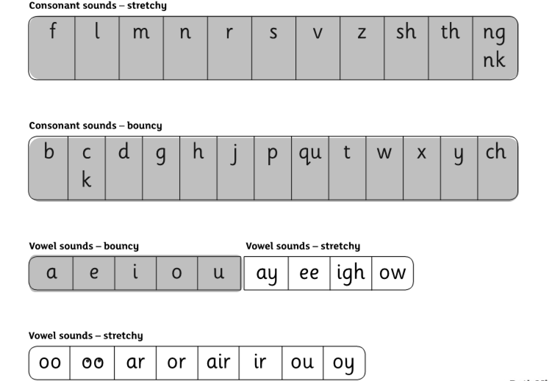
Set 1 Speed Sounds
We teach Set 1 first (the shaded sounds).
We use an approach known as Fred Talk using flash cards with the sounds on them.
Notes:
Read this as it is

Slide 13

Fred Talk
This is Fred.
He is a frog who can only speak in sounds, and we call this Fred Talk.
My Turn, Your Turn
Notes:
Play my turn your turn with Set 1 cards – tell parents the rhyme as well.

Slide 14
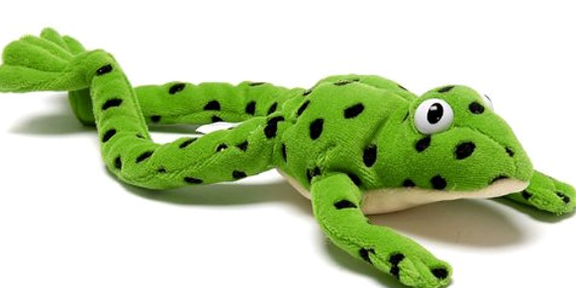
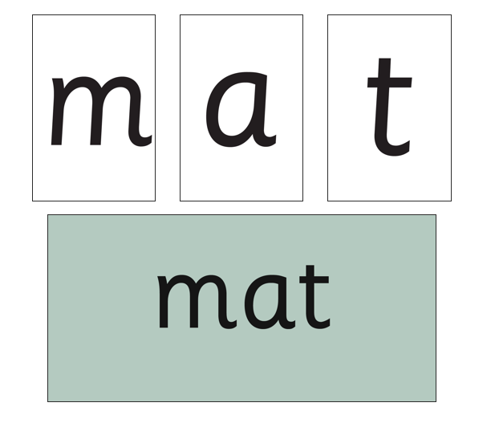
Using Fred Talk to blend
Once the children know the pure sounds, we teach them to blend sounds to read words.
My Turn, Your Turn
Notes:
Play my turn your turn with Set 1 word cards for simple words –

Slide 15
Set 2 Speed Sounds
We teach Set 2 next (the unshaded sounds).
Notes:
Read this as it is

Slide 16

Red Words
Some words are ‘tricky’ because they contain letters that don’t match the sounds the child has been taught.
For example, ‘said’ has ‘ai’ making an ‘e’ sound.
We call
these red words.
Notes:
Read as it is and remind parents we call them ‘red’ words.

Slide 17
Reading Books
Your child will bring home a book that is matched to their phonics learning. It may have a shiny front cover or a paper front cover.
We call these phonetically decodable books and your child should be able to read or decode all the words within it.

Slide 18
Useful resources for parents:
https://home.oxfordowl.co.uk/reading/reading-schemes-oxford-levels/read-write-inc-phonics-guide/
https://www.stanningtoninfants.co.uk/english-2/
How to say sounds video

Slide 19
Any questions?

