Slide 1
Welcome to Year 2

Slide 2
The Y2 Team
Class teachers:
Class 5: Mrs Harris – Monday, Tuesday and Wednesday
Miss Travil - Thursday and Friday
Class 6: Miss Travis
Class Teaching Assistants:
Class 5: Mrs Grayson/Ms Seaward
Class 6: Mrs Leaf

Slide 3
A typical morning:
Like Y1 the school day starts at 8:50 and finishes at 3:20. The children will need to arrive on the playground from 8.40am please by the red doors.
Early Work Books
We encourage the children to come into school and use the time before the bell to carry out set tasks on the whiteboard. These are tasks the children can do independently or with a partner from class.
Phonics
Literacy
Maths

Slide 4
Throughout the week in the afternoons we cover:
Whole Class Reading
Handwriting Practise
Science
Theme Work including:
History/Geography
Art/D&T
PE
PSHE
RE
Music/Singing
Computing

Slide 5
Theme
Next year’s themes will be:
Autumn – Our School
Spring – Sheffield
Summer- Rainforests
We will learn about people, places, buildings and/or famous historical events. We will investigate geographical features, both human and physical, as well as looking at either an art or a D&T focus (or possibly both!)

Slide 6
Termly Themes and Key Questions
Each term you will continue to receive a Curriculum Planner to let you know all about the learning we intend to cover as part of that theme.
We will also have a key questions to help ‘introduce, discuss and discover ‘ our chosen theme , which you will see on the planner, for example:
What makes Sheffield a great place to live? This key question was used to support learning about our local and national environment.

Slide 8
Literacy
Literacy is taught through narrative and non- fiction. The children will use the same story for half a term and use this to develop their writing skills. The non-fiction writing each term will be linked to our theme.
During Year 2 the children will build on their story telling and writing skills and will become accomplished writers by the end of the year.
Children will learn how to join their letters so they can write using joined handwriting. We teach handwriting twice weekly and reinforce throughout the week.
We teach children how to spell as part of the teaching sequence and reinforce this through weekly spelling quizzes.

Slide 9
How we teach writing: We immerse the children. We analyse the features of the text type. We teach particular skills the children will need for that text type. Then children plan their piece of writing. Next children write their piece before editing and reviewing it.
Writing

Slide 10
Stories
This year we used the following stories to support writing:
Little Red Riding Hood, Giddy Goat, George’s Marvellous Medicine, Traction Man and The Last Bear.

Slide 11
How to support your child’s writing at home:
Give it a purpose, let them write lists, labels, messages and greetings without copying and praise their attempts at independent writing
Talk about their writing
Let them see you writing
Encourage them to feel proud of their work.
Encourage them to ‘have a go’ and take risks.
Read stories and explain or pick out new or interesting vocabulary and phrases.

Slide 12
Whole Class Reading We teach the children how to understand a book and a range of comprehension skills. We focus on a book for a number of weeks. Small Group Reading In small groups we focus on fluency and reading for meaning. Phonics Children are taught in small groups to be able to read sounds and apply these skills into their reading. We also teach children about spelling patterns in order for them to use them in their writing independently.
Reading

Slide 13
Home Reading
Children are given a reading diary that we ask you to write in to show when they have read at home. Please return these every Monday.
Reading books will be changed on Mondays.
They will receive 2 phonetically decodable book (RWInc). This is your child’s reading book that they will use to learn to read and should read before any other book.
The children will also get a book for pleasure (a coloured book) and a library book, as well as access to online reading. More information about this can be found on the school website.

Slide 14
Home Reading
Please listen o your child read at least 5 times each week.
National research shows that children who read regularly at home, and are also read to, make more progress at school regardless of their starting point.
Little and often is the best approach – children should be practicing their reading so they should be able to read the book independently.
Book at Bedtime in the Autumn term
World Book Day

Slide 15
Maths
Maths is taught through a series of focus areas which may take a couple of weeks or up to a half term.
We begin the school year by looking at place value and the number system. This learning will underpin the other areas of learning throughout the year.

Slide 16
These are the areas of Maths we cover in Year 2. The terms are a guide and may change based on the needs of the children.
Autumn
Place Value
Addition and Subtraction
Spring
Properties of shape
Multiplication
and Division
Fractions
Addition and Subtraction
Summer
Money
Time
Statistics
Length and Height
Mass, Capacity and Temperature
Position and Direction
Additional
Problem solving

Slide 17
Maths
In maths sessions, the children begin by focusing on developing their mental and oral skills. This is a quick paced part of the lesson where children will practise recalling number bonds and times tables.
The children work in a variety of ways, usually starting with a practical activity using different resources, before moving onto using pictures and more formal recordings.

Slide 18
Here is some of the language the children will use when talking about Maths…
Hundreds, Tens and Ones :This makes up the place value of a number. We refer to these as columns.
Digit: All numbers are made up of the digits 0-9.
Value: What is the digit worth? - This will depend on which column the digit is in.
Partition: To partition a number means to split it into Hundreds, Tens and Ones.
1 digit number/ 2 digit number: A 1 digit number only has a digit in the ones column, a 2 digit number has digits in the tens and ones columns.
Crossing the ten/ regrouping: A term for moving between 10 ones and 1 ten- this is used in addition and subtraction.

Slide 19
How to support your child’s maths at home:
Give maths a context-
Talk about their maths learning and the maths you see in everyday life (i.e. when paying for something, when you have to share something out, when reading a timetable, when planning how long it will take to do an activity, when you spot shapes, see signs with numbers on, talk about dates, measurements when cooking, talk about the temperature when on holiday or when it’s cold outside and how it’s different)
Encourage a positive view of maths-
If you talk about maths negatively, they might adopt that view as well. Instead encourage them to ‘have a go’, take risks and see maths as a fun challenge. Maths is all about ’solving problems’. Its always better to have a go and get it wrong so that we know how to get the answer correct next time. It’s as much about the process of getting to the answer as the answer itself.

Slide 20
PE
In PE we focus on developing different skills, such as ball skills, gymnastics and dance movements where they will learn to control objects, apparatus and themselves physically in a variety of ways.
Children will also learn a number of team sports, learning about co-operation and fair play. During Year 2 children experience progressively more difficult tasks and attempt an increasing range of activities.

Slide 21
PE
We love to be active both in class and out. Please make sure that your child is wearing suitable shoes for our PE sessions.
Long hair tied up and all jewellery removed
PE days will be:
Class 5 Tuesday and Thursday
Class 6 Monday and Tuesday
They need to come in PE kits on these days.

Slide 22
Science
In Year 2, science is an exciting, hands-on subject where children learn to think like scientists. Our sessions are practical and encourage curiosity in the world around us.
Key areas of learning:
Children will learn to be curious and ask questions about the world around them.
We explore ideas through simple experiments.
Children make predictions, observe carefully, and record what they find out.
Pupils learn different ways to collect and show results.
We will make links to our school and our local area.
Many science topics are explored outdoor through Forest School.

Slide 23
Theme weeks
Each term we have at least one theme week to support and embed learning for certain subjects.
This year the children took part in:
Enterprise week – children made their own art work and Christmas decoration to sell at the Christmas Fair.
DT Week – developing design skills and creating moving puppets.
‘All About Me’ PHSE Week
Healthy Week – where the children have the opportunity to take part in different sporting activities.

Slide 24
Forest School is a big part of our learning during the Autumn term. The children will build on the skills they have developed through Forest School in Foundation and Year 1 as well as being given more independence. Some learning will be focused around our theme whist some will be specific to the outdoor setting. Forest School learning focuses on key Science, Art and D&T skills. Children will learn to work in a team and problem solve.
Forest School

Slide 25
Forest School Learning

Slide 26
Home Learning will be sent home weekly on Fridays via Google Classroom with a hand in date the following week (Sunday). Children will have home learning books that they should use to record their home learning. This can be uploaded as a picture to Google Classroom or handed in each Monday. Home learning is made up of weekly Maths and Spelling.
Home Learning

Slide 27
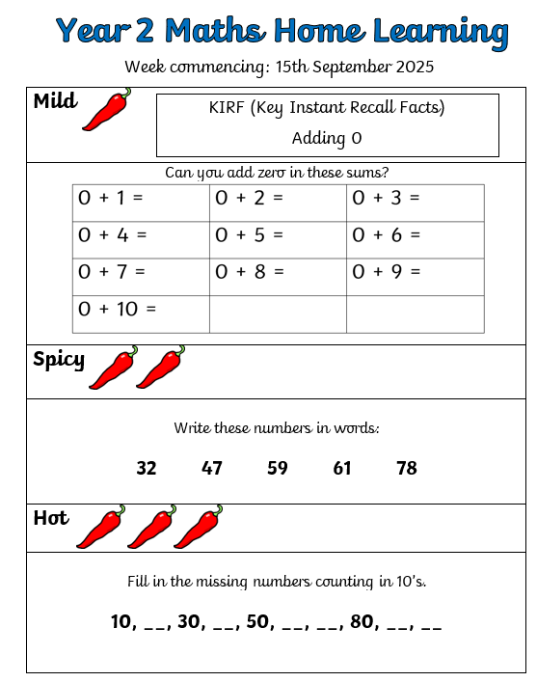
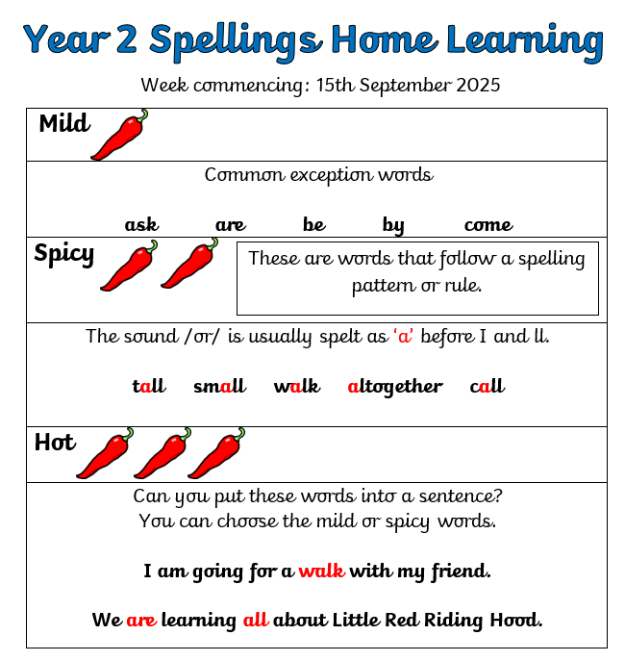

Slide 28
Our educational visits are lots of fun. We love learning from first hand experiences. In the Autumn term we have booked to visit the Crucible to see a live performance with Music in the Round. We also hope to visit the local area, the city centre and different places of religious worship. We try to balance out the cost of school trips across they year, which is why we are having workshops in school, visits to the local area as well as visits to other places.
Educational Visits

Slide 29
Visiting places of worship.

Slide 30
Fantastic Visits!

Slide 31
Fabulous singing at Young Voices

Slide 32
Working together at the EIS

Slide 33
Puppet week

Slide 34
Swimming Year 2 children go swimming in the Summer term. They go to Zest swimming baths. In Spring 2 Class 5 will go swimming and in Summer 1 Class 6 will go swimming. Please make sure your child can get undressed and dressed independently.

Slide 35
Ukulele
In Year 2 the children have a wonderful opportunity to learn the ukulele. At the end of Y2 they will perform in a ukulele assembly.

Slide 36
Job Squad
In Year 2 children are encouraged to have a Job Squad role. There are a number of job squad roles including, milk monitor, cloak room helper and litter picker. The children love having this responsibility and are keen to help and support in school.

Slide 37
In the Summer term each child will have a Year 5 reading buddy and read with them here and at Nook Lane in order to build relationships. Year 2 and Year 3 have a joint sports afternoon at Nook Lane. The Year 3 teachers will come to visit the Year 2 children for a morning at Stannington Infant School.
Transition to Nook Lane

Slide 38
We hope you have found this useful and look forward to seeing you in September.
Thank you
If you have questions about any of the above or next year please email us at:
lizharris@stannington.sheffield.sch.uk
mtravil@stannington.sheffield.sch.uk
stravis@stannington.Sheffield.sch.uk
Take care
The Year 2 Team

