Slide 1
Phonics Screening Information

Slide 2
What is Phonics?
Children are taught to read by breaking down (decoding) words into separate sounds or ‘phonemes’.
They are then taught how to blend these sounds together to read the whole word.
Children are taught phonics in groups based on their ability but also as part of all literacy sessions.

Slide 3
Why are the children screened?
Every Year 1 child across the country will be taking the phonics screening check in the same week in June.
Children in Year 2 will also take the check if they did not achieve the required result when in Year 1 or they have not taken the test before.
The phonics screening check is designed to confirm whether individual children have learnt phonic decoding and blending skills to an appropriate standard.

Slide 4

What happens?
The check is very similar to tasks the children already complete during phonics lessons. There is no reason for children to worry about the test. They are used to the way phonics is assessed!
Children will be asked to ‘sound out’ (decode) a word and blend the sounds together.eg d-o-g - dog
The focus of the check is to see which sounds the children know and therefore the children will be asked to read made up ‘alien - nonsense’ words.

Slide 5
What happens?
The test contains 40 words.
Each child will sit one-to-one and read each word aloud to a teacher.
The test will take approximately 10 minutes per child.
The list of words the children read is a combination of 20 real words and 20 nonsense (alien) words.
Mrs Starkey or a familiar adult will carry out the test with the children.

Slide 6
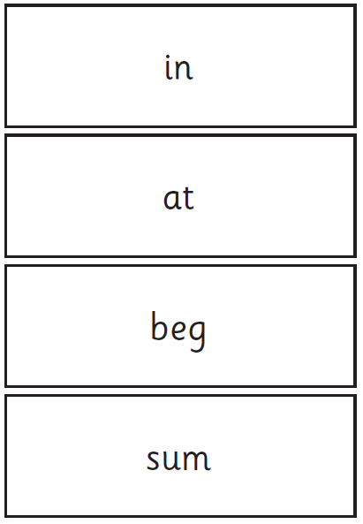
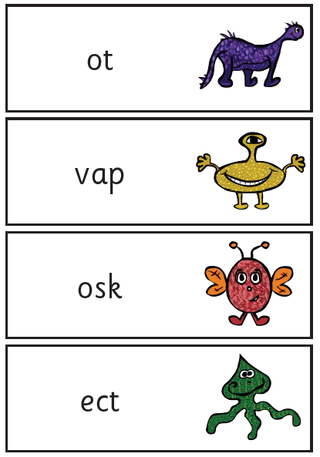
Examples

Slide 7
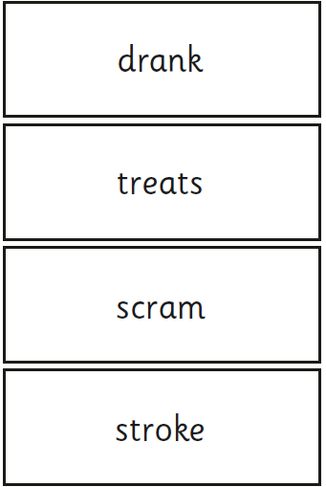
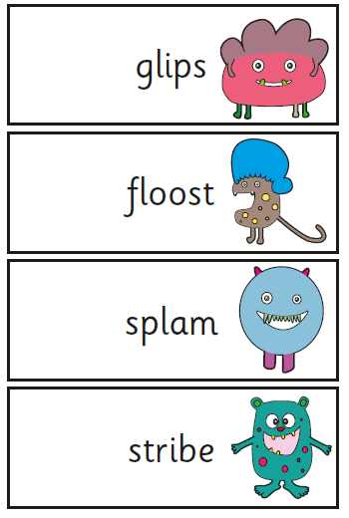

Slide 8
When will it take place?
The screening will take place throughout the week beginning Monday 8^{h} June. It is very important your child is in school during this week!
By the end of the summer term all schools must report each child’s results to their parents. They will also confirm if the child has met the standard threshold. Children who do not achieve the expected level will retake the test when they are in Year 2.

Slide 9
How can you help?
Encourage your child to ‘sound out’ (decode) when reading or writing. Focusing particularly on spotting sounds (special friends) using their finger or by drawing dots and dashes. Some digraphs have more than one sound ow – blow and ow – brown so they need to check the word makes sense when reading them in real words.
Digraph- 2 letters making one sound
cow
Trigraphs- 3 letters making one sound
night
Split digraphs- 2 vowels with a consonant in between. We tell the children to look for an “e” near or at the end of a word.
spine - i-e

Slide 10
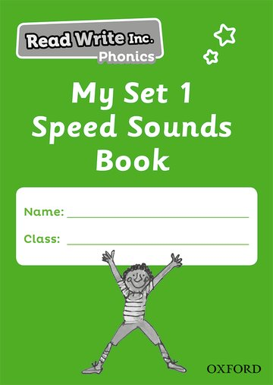
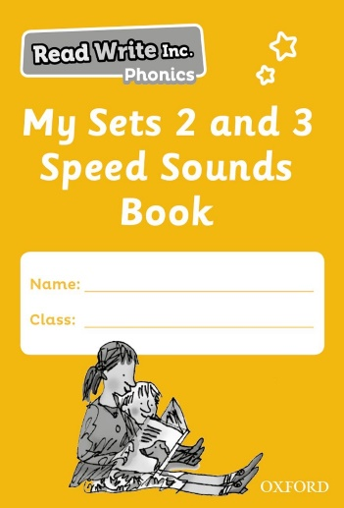
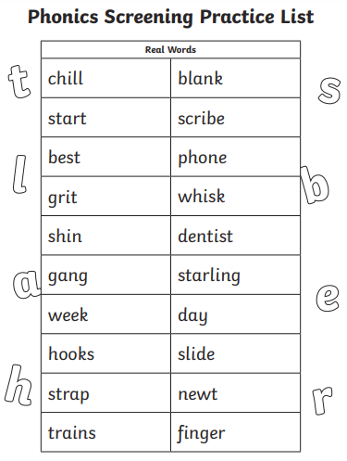
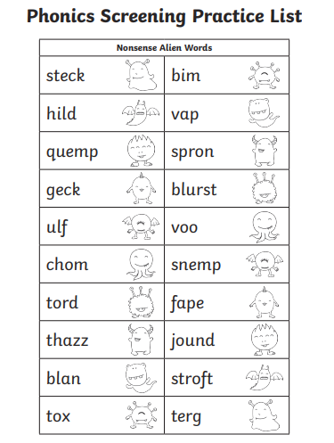
Support your child in learning all the sounds in their phonics sound books.
There are other sounds that are not in the book such as ie – fried, ue – blue, au – august, c – ice, e-e - trapeze
Complete your child’s home learning with them as practise sheets will be uploaded to Google Classroom this half term.

Slide 11
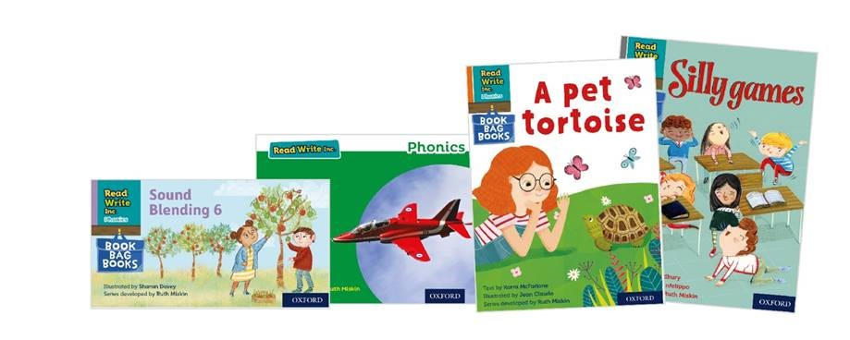
Read regularly with your child at home using their Read Write Inc. (RWI) phonetically decodable book (This is where all the words in the book can be sounded out and blended back together.)
Encourage your child to break down longer words when decoding them. For example midnight can be broken down into mid – night and then blended together to read it as a whole word.

