Slide 1

Readiness to Read at Stannington Infant School

Slide 2
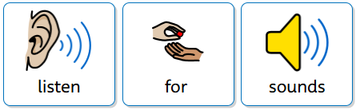
Getting Ready to Read
Before children learn to read sounds and words they need to be able to listen for sounds.
Notes:
Read as it is

Slide 3
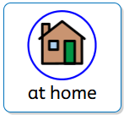
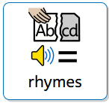
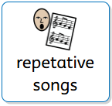
There are lots of things you can do at home to support this.
Twinkle, Twinkle Little Star
The Gruffalo (or any Julia Donaldson books)
Wind the Bobbin Up, Wheels on the Bus
Humpty Dumpty, Heads, Shoulders, Knees and Toes
B- I – N- G- O

Slide 4

Stories
Stories –
Listening to stories
Notes:
Read as it is

Slide 5

Clapping Sounds
Clap their name
Clap sounds in a word

Slide 6
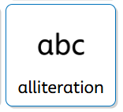
Alliteration Games
Liz loves lollies
Harry hides honey
Connie can cartwheel
Sam shares sweets

Slide 7
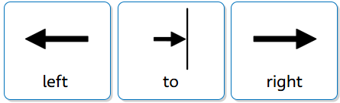

Preparing to read a word or a book
Tracking
Children need to be able to track from left to right with their eyes and head when they read. Reading paper books helps this.
Notes:
Read as it is

Slide 8
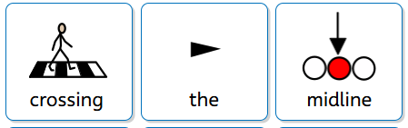
Preparing to read a word or a book
Crossing the Midline
Touch your ear with the opposite hand
Touch your knee with your opposite hand.
Notes:
Read as it is

Slide 9

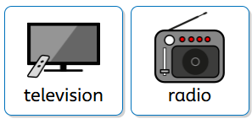

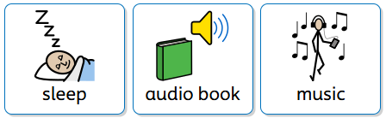
Quiet times
Do you leave the TV or the radio on when you are in
the house?
Do you go for a walk with your ear pods/headphones in?
Do you go to sleep listening to a Podcast/music/audio book?
Notes:
Read as it is

Slide 10
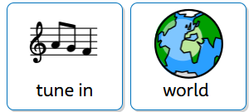
Quiet times
Quiet is important for all of us.
Having quiet times within your day is helpful for you and your children to tune in with the world around.
Notes:
Read as it is

Slide 11

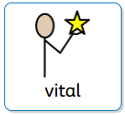
Reading at Home
Reading at home is vital.
Sharing a physical book with your child is such an important part of their reading journey. Learning how to turn a page themselves, tracking text as you read it and hearing your voice as you read has the biggest impact on children.
Please do this as often as you can, even when it is
tempting to put an audio book on or turn on the TV.
Notes:
Read as it is

Slide 12

Things to do over the summer:
Read, read, read:
  Read to
  Read with
  Read books
Listen to different sounds – take 3 objects that all make a different sound, can your child tell you what it is?
Sound walks
Quiet time

Slide 13
How do we teach your child to read?
In October we will holding a workshop explaining how we teach your child to read covering the following:
Introducing you to Read Write Inc
What are pure sounds?
What are speed sounds?
What is Fred Talk?
When will my child bring a book home?

Slide 14
Any questions?

