Slide 1
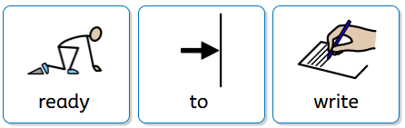
Readiness to Write at Stannington Infant School

Slide 2
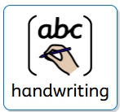
Why handwriting?
The relevance of handwriting is sometimes questioned in a day and age when we are surrounded by laptops, iPads and smart phones. But the teaching of handwriting is just as important now as it ever has been.
The need to create something of beauty never leaves the human brain and nothing beats that feeling of personal triumph when we look at something we have completed ourselves.

Slide 3
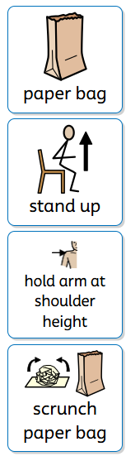

Getting Ready to Write……
Pick up the paper bag!!!!
Stand up
Hold your arm at shoulder height
Scrunch the paper bag into as small a ball as you can.
Now unfold it using only that hand without lowering your arm.

Slide 4
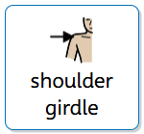
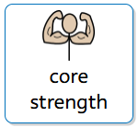
Core Strength and Shoulder Girdle
These two things are key in preparing children to write.

Slide 5
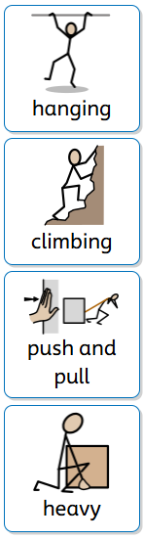
Core Strength and Shoulder Girdle
Things to strengthen these areas:
hanging from monkey bars
climbing
pushing and pulling
weight baring – carrying/holding heavier things

Slide 6
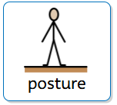
Core Strength and Shoulder Girdle
Developing these two areas of strength can also help with
Postural Control
To be able to write children need to be able to maintain their posture or writing position for short periods of time, longer as they go through school.

Slide 7
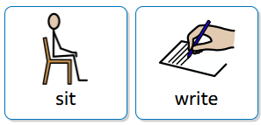
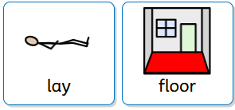
Core Strength and Shoulder Girdle
Can your child sit and write for a few minutes at a
time with a straight back?
Can they lay on the floor for a period of time and write or colour?

Slide 8
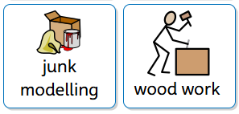
Junk Modelling/Wood Work
Develops gross and fine motor skills
Develops dexterity
Problem solving
Cutting skills
Sticking skills
All of the above help to develop the skills and strength needed for writing.

Slide 9
Other things to know and try ….

Slide 10
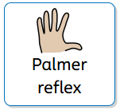
Palmer Reflex
Being able to hold your hand open when doing ‘Round and round the garden’ helps children prepare to be able to hold a pencil.
If they react by closing their hand, keep practising until they no longer do this.

Slide 11
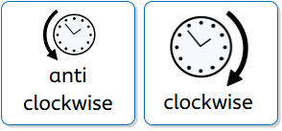
Other things to know and try ….
Can your child move both arms independently of each other?
Can they make an anti clockwise circle with one arm and a clockwise one with the other?
All of these help to develop the skills and strength needed for writing.

Slide 12

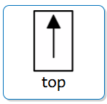
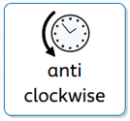
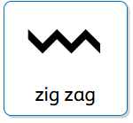
Things to do over the summer….
Drawing lines starting at the top and go down.
  (l, i, h, t, b all start at the top)
Draw circles anti clockwise
  (o,a,c and d all start from an anti clockwise direction)
Zig Zag
  (down then up like a w, v or x)

Slide 13
How do we teach your child to write?
In October we will holding a workshop explaining how we teach your child to write covering the following:
Introducing you to our handwriting approach
What is Pinchy Parrot?
How do we hold a pencil?
How do we form our letters?
What is a tripod grip and why is it important?

Slide 14
Questions?
Thank you for your time.

