Slide 1
Welcome to Year 2

Slide 2
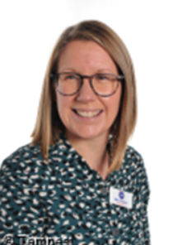
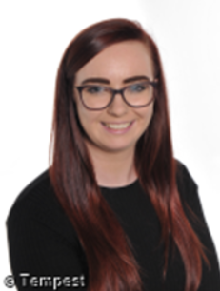

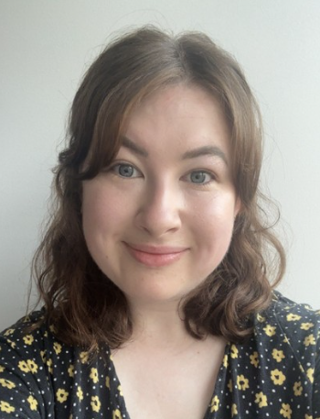
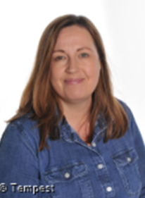
The Y2 Team
Class teachers:
Class 5: Mrs Cann
Class 6: Miss Travis
Class Teaching Assistants:
Class 5: Mrs Platts and Miss Renwick
Class 6: Mrs Leaf

Slide 3
The aim of this PowerPoint is to provide you with as much information as we can about Year 2. We know that many of you will have no experience of what happens in Year 2 and what the children will be doing.
On Monday 13th July there will be an opportunity for parents to come and see the Year 2 classes after school.

Slide 4
A typical morning
Like Y1 the school day starts at 8:50 and finishes at 3:20. The children will need to arrive on the playground from 8.40am please by the red doors.
We encourage the children to come into school and use the time before the bell to carry out set tasks on the whiteboard. These are tasks the children can do independently or with a partner from class.
It is important that you arrive on time for the doors opening at 8:40am. The morning work allows children to settle in and for staff to check in with the children as well as complete the dinner register and travel tracker.

Slide 5
Throughout the week in the afternoons we cover:
Shared Reading
Science
History
Geography
Art/D&T
PE
PSHE
RE
Music/Singing
Computing
Circle time

Slide 6
Topic
Next year’s topics will be:
Autumn – Toys
Spring – Our Country
Summer- Our Changing World
We will learn about people, places, buildings and/or famous historical events. We will investigate geographical features, both human and physical, as well as looking at either an art or a D&T focus (or possibly both!)

Slide 7
Termly Topics and Key Questions
Each term you will continue to receive a Curriculum Planner and Knowledge Builder to let you know all about the learning we intend to cover as part of that theme.
We will also have key questions to help ‘introduce, discuss and discover ‘ our chosen topic, which you will see on the planner.

Slide 8
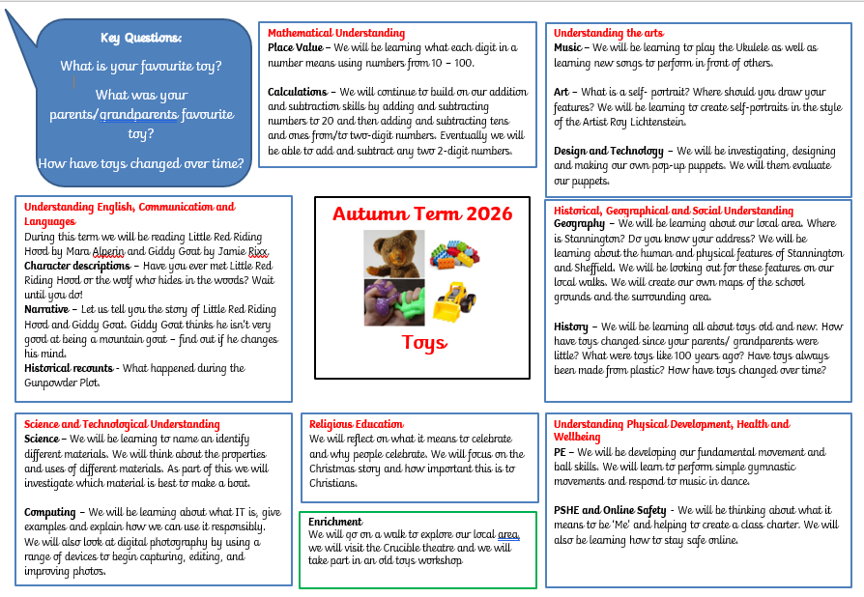

Slide 9
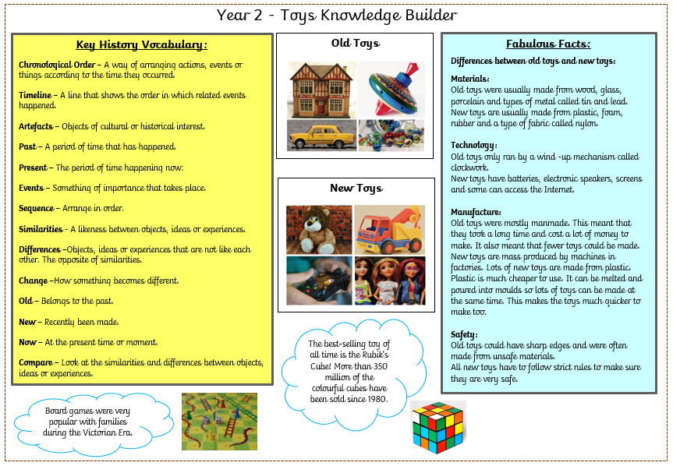

Slide 10
Literacy
Literacy is taught through narrative and non- fiction. The children will use the same story for half a term and use this to develop their writing skills. The non-fiction writing each term will be linked to our topic.
During Year 2 the children will build on their story telling and writing skills and will become accomplished writers by the end of the year.
Children will learn how to join their letters so they can write using joined handwriting. We teach handwriting at the beginning of every Literacy lesson.
We teach children how to spell as part of the teaching sequence and reinforce this through weekly spelling quizzes.

Slide 11

How we teach writing:
We immerse the children.
We analyse the features of the text type.
We teach particular skills the children will need for that text type.
Then children plan their piece of writing.
Next children write their piece before editing and reviewing it.
Writing

Slide 12




Stories
This year we used the following stories to support writing:
Little Red Riding Hood, Giddy Goat, George’s Marvellous Medicine and Traction Man.

Slide 13
How to support your child’s writing at home:
Give it a purpose, let them write lists, labels, messages and greetings without copying and praise their attempts at independent writing
Talk about their writing
Let them see you writing
Encourage them to feel proud of their work.
Encourage them to ‘have a go’ and take risks.
Read stories and explain or pick out new or interesting vocabulary and phrases.

Slide 14
Shared Reading
We teach the children how to understand a book and a range of comprehension skills. We focus on a book for a number of weeks.
Small Group Reading
In small groups we focus on fluency and reading for meaning.
Phonics
Children are taught in small groups to be able to read sounds and apply these skills into their reading. We also teach children about spelling patterns in order for them to use them in their writing independently.
Reading

Slide 15
Home Reading
Children are given a reading diary that we ask you to write in to show when they have read at home. Please return these every Monday.
Reading books will be changed on Mondays.
They will receive 2 phonetically decodable book (RWInc). This is your child’s reading book that they will use to learn to read and should read before any other book.
The children will also get a book for pleasure (a coloured book) and a library book, as well as access to online reading. More information about this can be found on the school website.

Slide 16
Home Reading
Please listen to your child read at least 5 times each week. Children will get a stamp in their reading diary if they have read 5 times a week. Those children then get the opportunity to have a story with Mrs Harris each half term.
National research shows that children who read regularly at home, and are also read to, make more progress at school regardless of their starting point.
Little and often is the best approach – children should be practicing their reading so they should be able to read the book independently.
Book at Bedtime in the Autumn term
World Book Day in the Spring Term

Slide 17
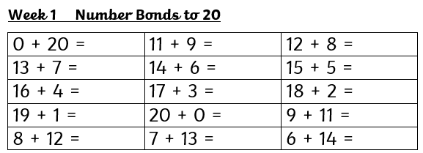
Maths
There is a strong emphasis on developing instant recall of number facts.
These are called KIRFs (Key Instant Recall Facts).
Children in Year 2 need to be able to count in steps and recall their 2,5, 10 times tables

Slide 18
Steps of learning
The children are introduced to new concepts in a three stage approach (C-P-A) to help scaffold their learning.
The children may go back a forth in this process.
Concrete
‘doing’
The children begin by using objects to help them learn in a more familiar way.
Pictorial
‘seeing’
The children then use models and images to help them make links.
Abstract
‘symbolic’
Finally the children move onto use just numbers and abstract symbols.
The way we teach maths is the same across the whole of KS1
Notes:
The way we teach maths is the same across the whole of KS1 ie the CPA

Slide 19
These are the areas of Maths we cover in Year 2. The terms are a guide and may change based on the needs of the children.
Autumn
Place Value
Addition and Subtraction
Spring
Properties of shape
Multiplication
and Division
Fractions
Addition and Subtraction
Summer
Money
Time
Statistics
Length and Height
Mass, Capacity and Temperature
Position and Direction
Additional
Problem solving

Slide 20
Here is some of the language the children will use when talking about Maths…
Hundreds, Tens and Ones :This makes up the place value of a number. We refer to these as columns.
Digit: All numbers are made up of the digits 0-9.
Value: What is the digit worth? - This will depend on which column the digit is in.
Partition: To partition a number means to split it into Hundreds, Tens and Ones.
1 digit number/ 2 digit number: A 1 digit number only has a digit in the ones column, a 2 digit number has digits in the tens and ones columns.
Crossing the ten/exchanging/regrouping: A term for moving between 10 ones and 1 ten- this is used in addition and subtraction.

Slide 21
How to support your child’s maths at home:
Give maths a context-
Talk about their maths learning and the maths you see in everyday life (i.e. when paying for something, when you have to share something out, when reading a timetable, when planning how long it will take to do an activity, when you spot shapes, see signs with numbers on, talk about dates, measurements when cooking, talk about the temperature when on holiday or when it’s cold outside and how it’s different)
Encourage a positive view of maths-
If you talk about maths negatively, they might adopt that view as well. Instead encourage them to ‘have a go’, take risks and see maths as a fun challenge. Maths is all about ’solving problems’. Its always better to have a go and get it wrong so that we know how to get the answer correct next time. It’s as much about the process of getting to the answer as the answer itself.

Slide 22
PE
In PE we focus on developing different skills, such as ball skills, gymnastics and dance movements where they will learn to control objects, apparatus and themselves physically in a variety of ways.
Children will also learn a number of team sports, learning about co-operation and fair play. During Year 2 children experience progressively more difficult tasks and attempt an increasing range of activities.

Slide 23
PE
We know the importance of children being active throughout the day. Active children do better in every possible way. They perform better in school and physical activity can increase levels of concentration.
Each week we focus on developing fundamental skills such as ball skills, balance and co-ordination. Children also take part in gymnastics and dance lessons.
We aim to be active throughout the day as children learn best after physical activity. Each day we will do Active 10 challenges. This is 10 minutes of physical activity and can include following a zumba session, a Go Noodle dance routine or playing an active game.

Slide 24
PE days are:
Class 5 – Tuesday and Thursday
Class 6 – Monday and Tuesday
They will not take place during the first week of term in September.
Children will need to come to school wearing leggings / joggers and a polo shirt type top on PE days. They will also need to wear suitable footwear such as trainers.
No jewellery please - earrings must be taken out not taped up! If children do wear earrings they must be able to take them out and put them in by themselves.
Long hair to be tied up.
If your child has a verruca they are to wear socks and shoes (trainers or pumps).

Slide 25
Science
In Year 2, science is an exciting, hands-on subject where children learn to think like scientists. Our sessions are practical and encourage curiosity in the world around us.
Key areas of learning:
Children will learn to be curious and ask questions about the world around them.
We explore ideas through simple experiments.
Children make predictions, observe carefully, and record what they find out.
Pupils learn different ways to collect and show results.
We will make links to our school and our local area.
Many science topics are explored outdoor through Forest School.

Slide 26
Theme weeks
Each term we have at least one theme week to support and embed learning for certain subjects.
This year the children took part in:
Enterprise week – children made their own art work and Christmas decoration to sell at the Christmas Fair.
DT Week – developing design skills and creating moving puppets.
Healthy Week – where the children have the opportunity to take part in different sporting activities.

Slide 27
Forest School is a big part of our learning during the Autumn term.
The children will build on the skills they have developed through Forest School in Foundation and Year 1 as well as being given more independence.
Some learning will be focused around our theme whist some will be specific to the outdoor setting. Forest School learning focuses on key Science, Art and D&T skills. Children will learn to work in a team and problem solve.
Forest School

Slide 28
Home Learning will be sent home weekly on Fridays via Google Classroom with a hand in date the following week (Monday).
Children will have a purple home learning book that they should use to record their home learning and handed in each Monday.
Home learning is made up of weekly Maths and Spelling.
Home Learning

Slide 29
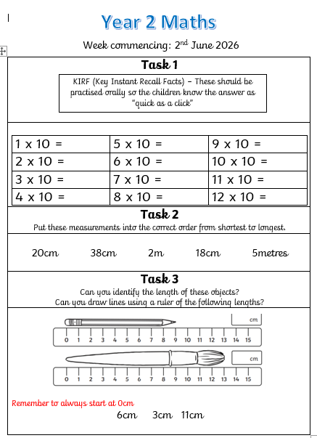
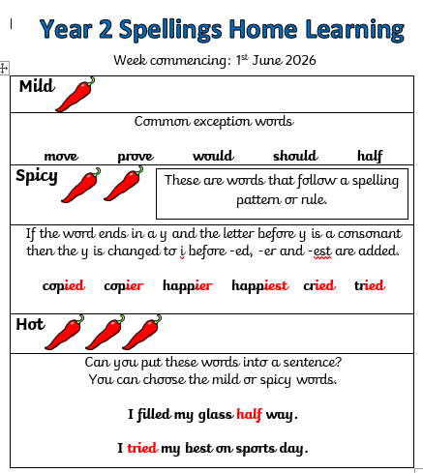

Slide 30
Our educational visits are lots of fun.
We love learning from first hand experiences.
In the Autumn term we have booked to visit the Crucible to see a live performance with Music in the Round.
We try to balance out the cost of school trips across they year, which is why we are having workshops in school, visits to the local area as well as visits to other places.
Educational Visits

Slide 31
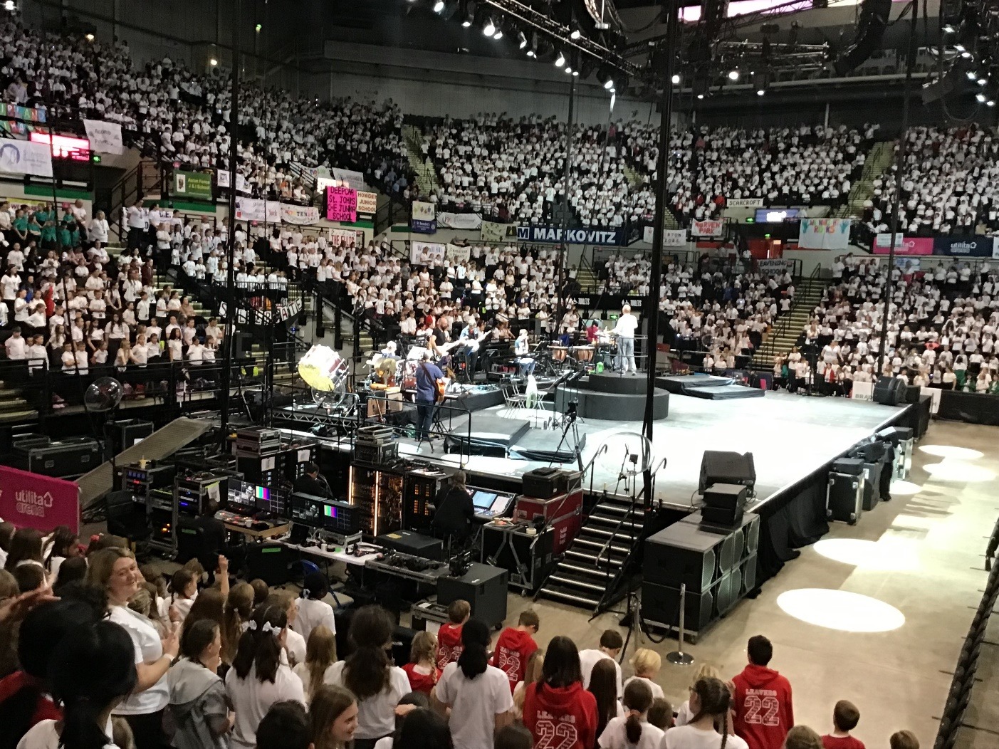
Fabulous singing at Young Voices

Slide 32
Ukulele
In Year 2 the children have a wonderful opportunity to learn the ukulele. At the end of Y2 they will perform in a ukulele assembly.

Slide 33
Job Squad
In Year 2 children are encouraged to have a Job Squad role. There are a number of job squad roles including, milk monitor, cloak room helper and litter picker. The children love having this responsibility and are keen to help and support in school.

Slide 34
In the Summer term each child will have a
Year 5 reading buddy and read with them here and at Nook Lane in order to build relationships.
Year 2 and Year 3 have a joint sports afternoon at Nook Lane.
The Year 3 teachers will come to visit the Year 2 children for a morning at Stannington Infant School.
Transition to Nook Lane

Slide 35
Attendance

Slide 36
Reminders…
Please put your child’s first name and surname in all their belongings. This is very important!
If you think your child may need a change of clothes for any reason please either send a named bag to school which can stay on their peg, or put clothes in their book bag.
Arrive at school on time at 8:40am so that children feel settled and ready to learn. We always have a busy exciting day planned and need to get started straight away.
If someone other than yourself is collecting your child please email the office or speak to the class teacher. If this is on a regular basis please let the class teacher know in September.
Please encourage your child to be independent where possible for example zipping up their own coat or tying their shoes.

Slide 37
We hope you have found this useful and look forward to seeing you in September.
Thank you
If you have questions about any of the above or next year please email us at:
stravis@stannington.sheffield.sch.uk
acann@stannington.Sheffield.sch.uk
Please allow 48 hours for staff to reply to emails.

