Slide 1

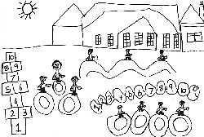
Welcome to Stannington Infant School
A friendly and creative environment for learning together
Staff
Miss Gore – Class 1 Teacher and EYFS Lead
Mrs Greensmith – Class 2 Teacher Mon, Tue, Wed
Mrs Birtles – Class 2 Teacher Thur, Fri
Teaching Assistants
Miss Mistry
Mrs Ashford
Miss Siddall
Miss Renwick
Notes:
Welcome to Stannington Infant School. We are delighted that you have chosen for your child to come to our school and we look forward to welcoming both you and your child in September.

Slide 2
Reminders…..
School snack policy
Water bottles- no juice please! Healthy reasons and a sticky mess!
Using a knife and fork
Name clothing
Let the school office know if there are changes to collection
Please inform the office of absences by 9:30 am and any medical appointments in advance

Slide 3
Collection
Please can you stand back from the white railings and watch for your child to come to the front of the line.
As tempting as it is, please do not wave if your child isn't at the front! This will also help staff who may not know you all as quickly as we do.
We understand that many of you are collecting from 2 classrooms. KS1 staff will hold on to your child until you walk around. Please do not worry. It is more important that we hand your child too you safely.

Slide 4
What does your child do all day?!
Responses from ‘nothing’ to a full daily recount, including who fell over, are completely normal!

Slide 5
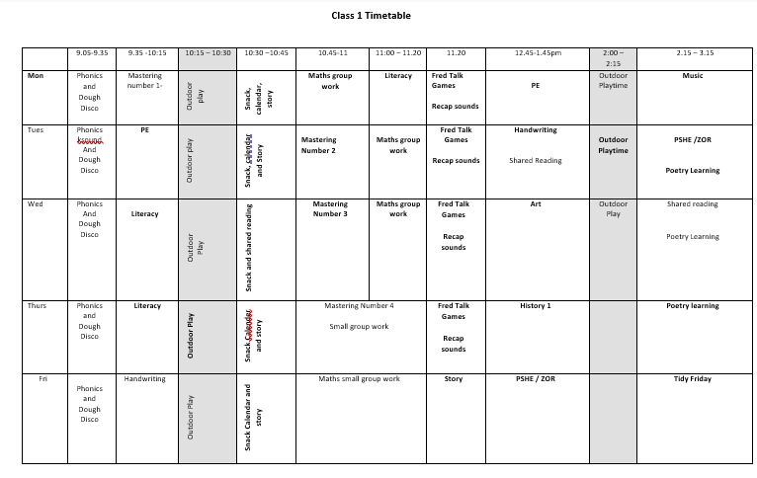
The reality we are working towards….

Slide 6
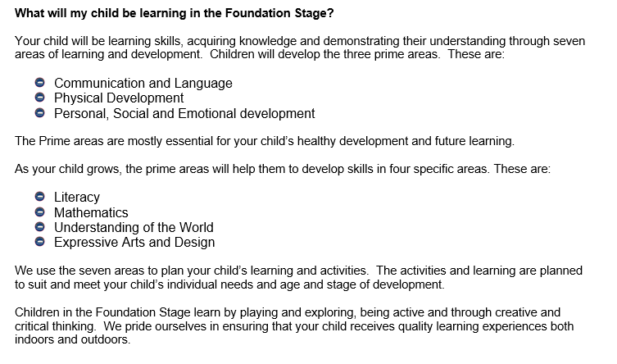

Slide 7
How does my child learn?
Whole class teaching
Small group work- adult led
Child initiated play- little intervention from adults
Child initiated play with additional intervention from adults
Small, targeted group work
Outdoor learning
Forest School – Summer term

Slide 8
Forest School.
Outdoor classroom
Outdoor wear, although in summer term so no snowsuits needed!
Summer term – 1 half term per class each Friday.
Parent volunteers are welcome
Full information will be sent out at the end of the Spring term.

Slide 9
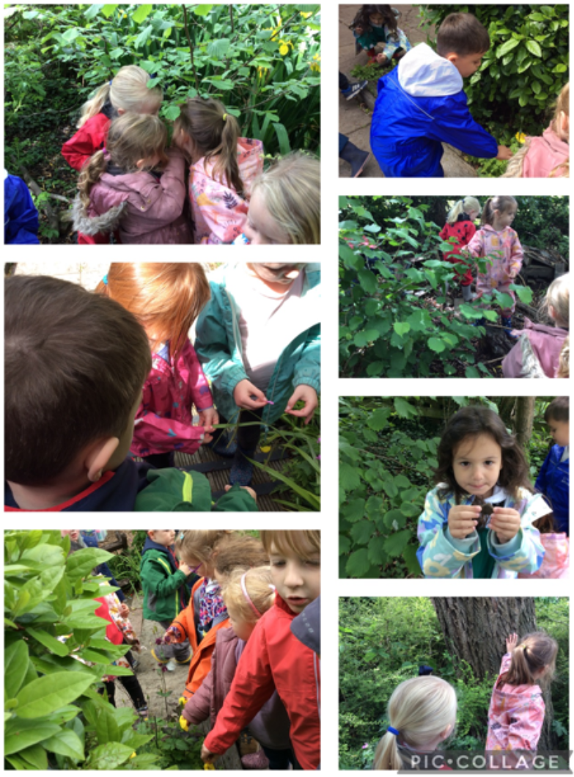

Slide 10
Visits and experiences
Autumn – Christchurch
Spring – Animal Encounters workshop
– Celebration of work assembly. Parents invited.
Summer – Local area walk
– Gingerbread Man workshop

Slide 11
Inviting you in…..
Old Toys workshop.
Please ask grandparents for any items they may be willing to bring in.
Book at Bedtime.
Look out for the parent mail. This is usually before Christmas.
Family workshops
Twigs and Trees, February 2027. Booking details to be sent out after Christmas

Slide 12
Online Platforms
We are introducing a new online learning platform which will replace Google Classroom. This will be trialled with Foundation Stage. Further information will be communicated as soon as this is available.
Mr Mitchell is in the process of setting up a Facebook page to share news with parents / carers.

Slide 13
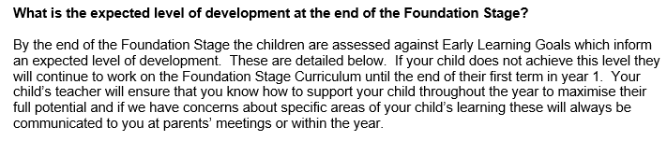
Is my child assessed / tested at the end of the year?
We will give parents more information about the GLD at parents evening

Slide 14
What can I do to help?
Sounds 5 x a week.
Knife and fork
Coat
Open snack (bananas, satsumas )
Discuss Lunch options the day before

Slide 15
Finally….
We are here to help. Please ask to speak to a member of staff if you have any questions or concerns.
If you have a payment, pick up, general information query then please contact the school office.

Slide 16
Questions
?

